Slide 1


Part 3 – Implementing Transformer from Scratch with Python & PyTorch
Quang Duong

Slide 2
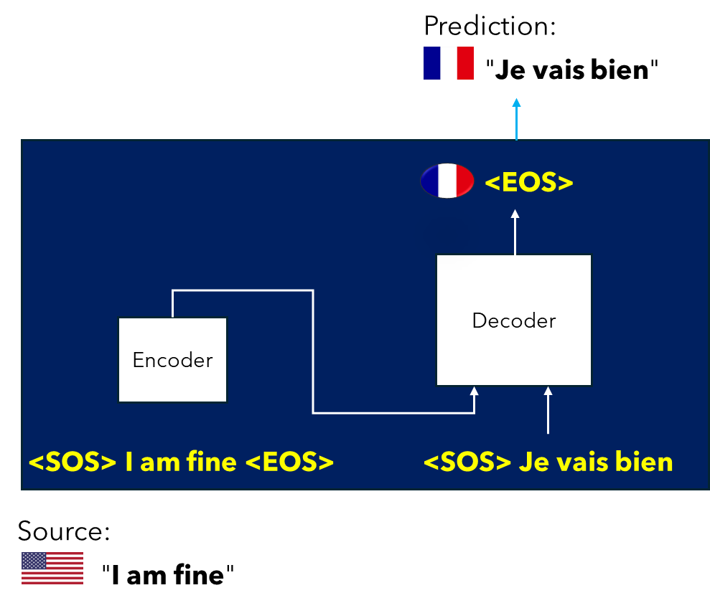
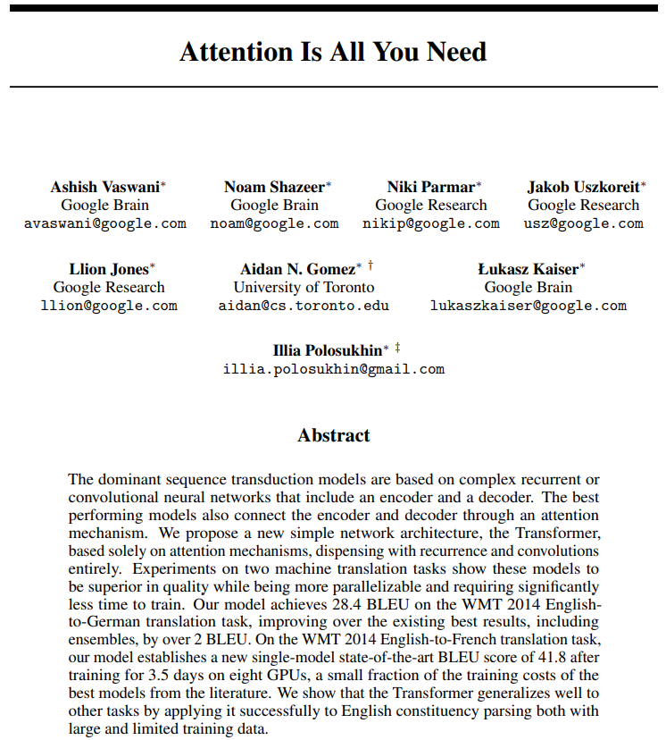
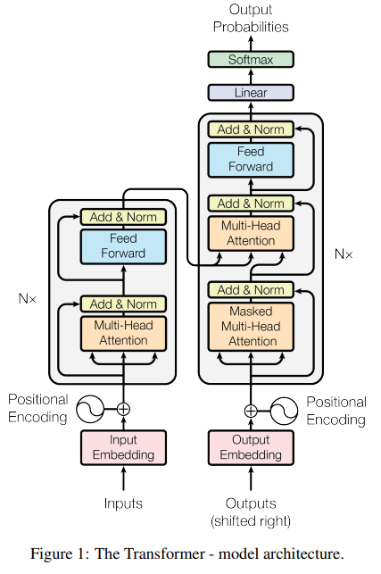
In the first part, …
Attention Is All You Need, A. Vaswani et al, 2017,
https://arxiv.org/abs/1706.03762

Slide 3
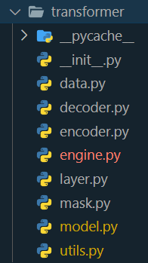
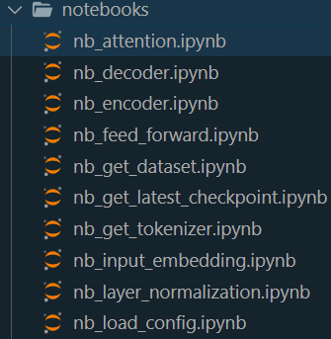
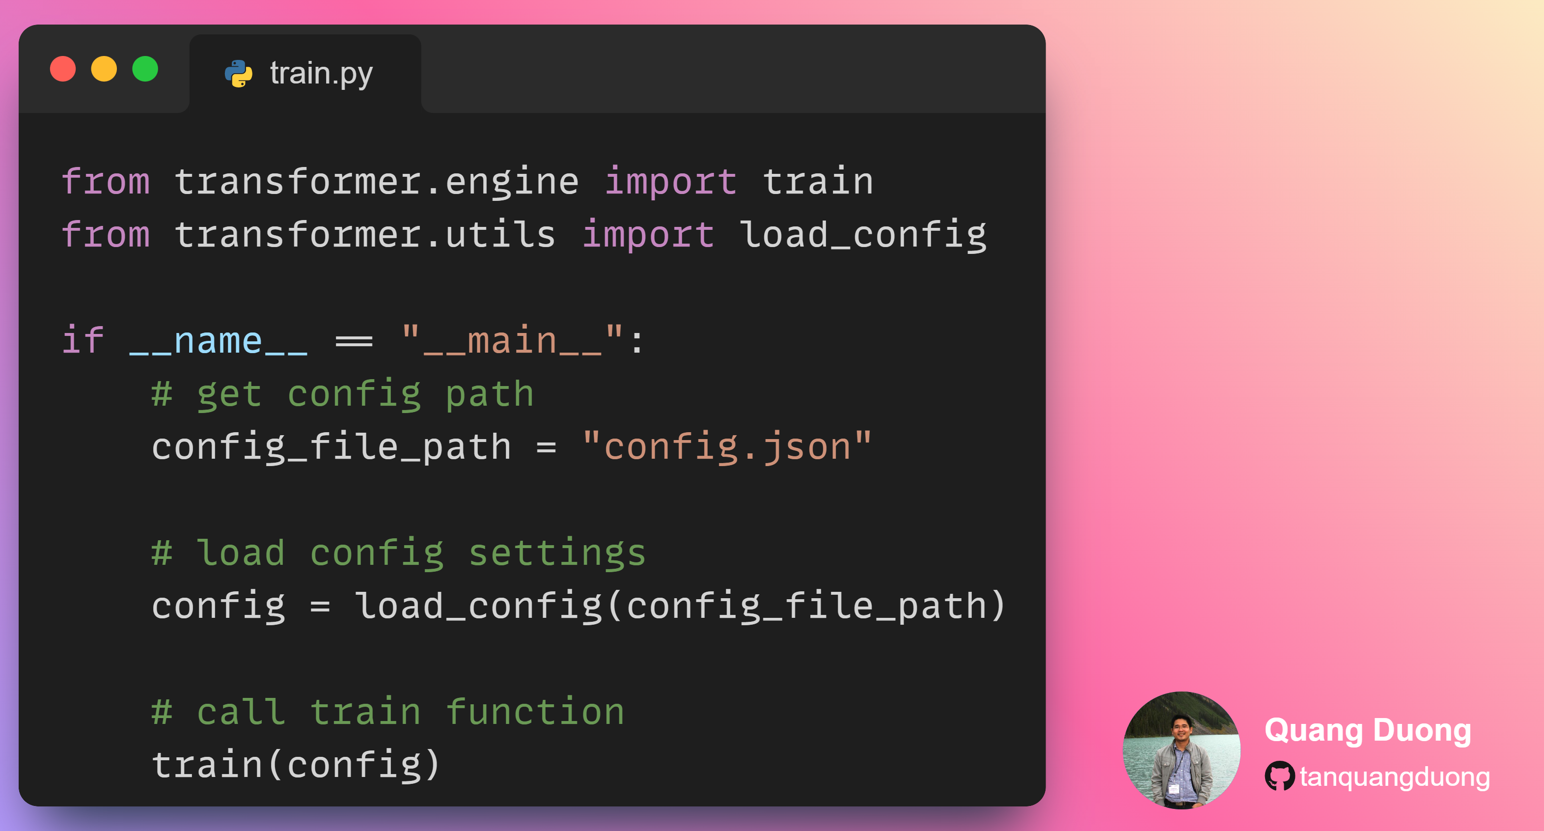
What we will obtain
Build a transformer package
Write train and inference scripts
Experimentation with notebooks

Slide 5

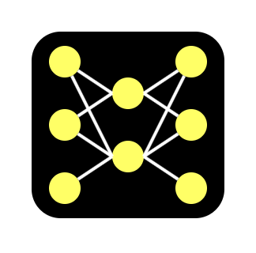


Implementation plan
Training
Inference
Source sentences
Training
Trained model
Target sentences
Trained model
Source sentence
Translated sentence

Slide 6
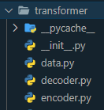
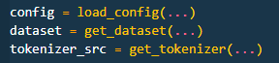
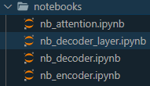
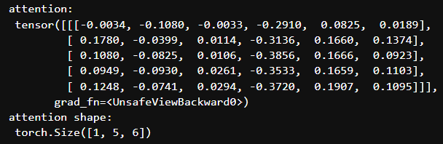
Implementation's formula
Source code
Coding step-by-step
Notebook
Example result
+
=
A good understanding of implementation
+
+

Slide 8
Training
Source sentences
Training
Trained model
Target sentences

Slide 10
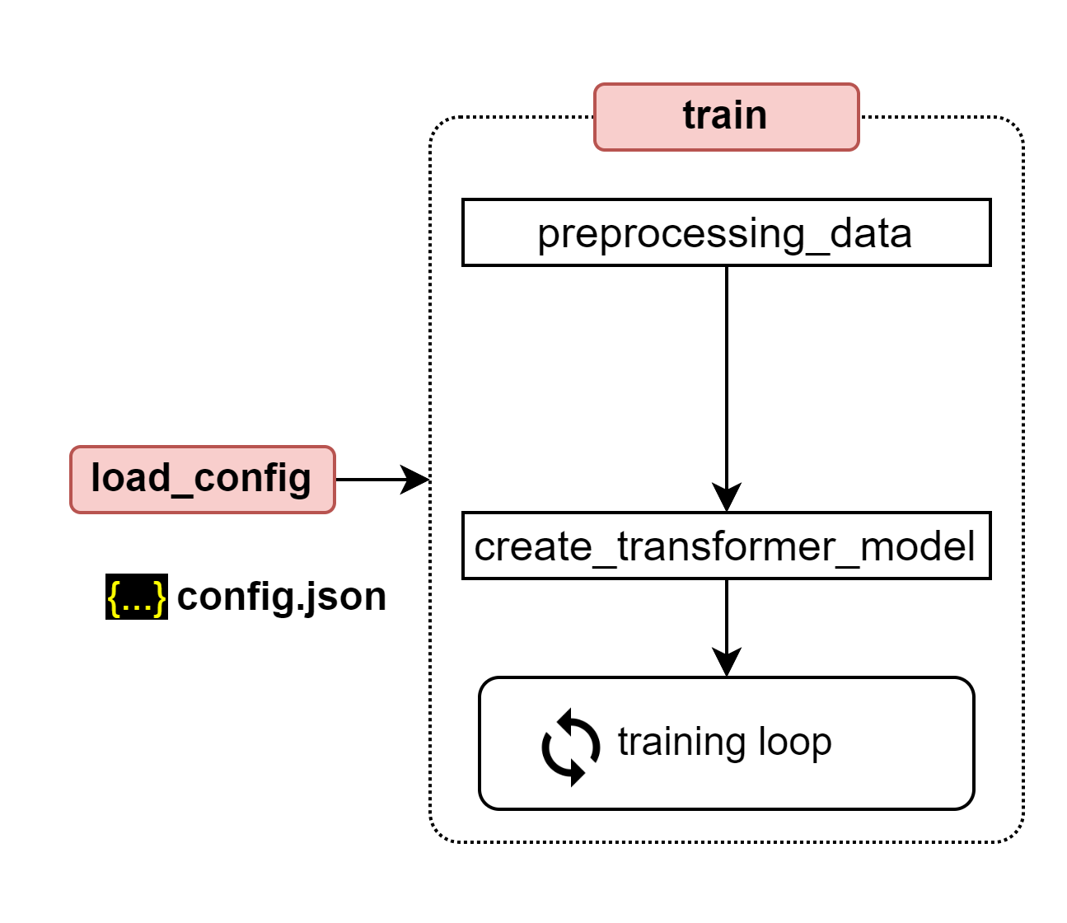
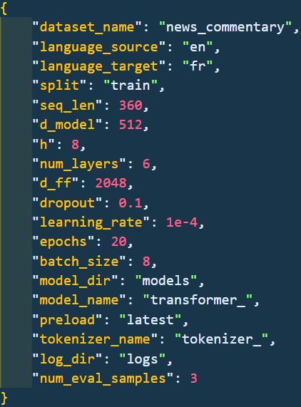
Training steps
Loading configuration

Slide 11
Training steps
Loading configuration
Training engine
Pre-processing data
Create and initiate transformer model
Training loop

Slide 12
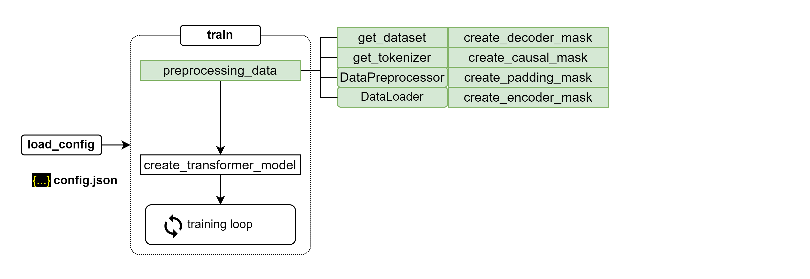
Preprocessing data

Slide 13
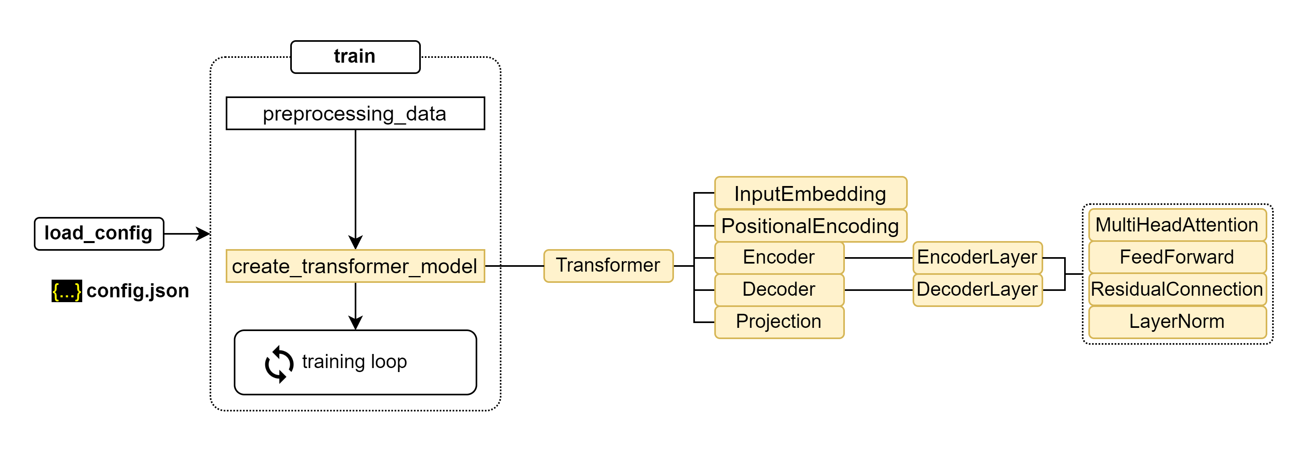
Create transformer model

Slide 14
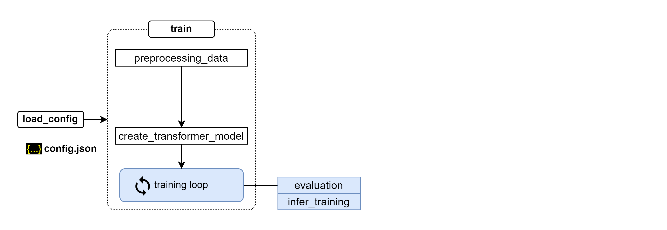
Training loop

Slide 15
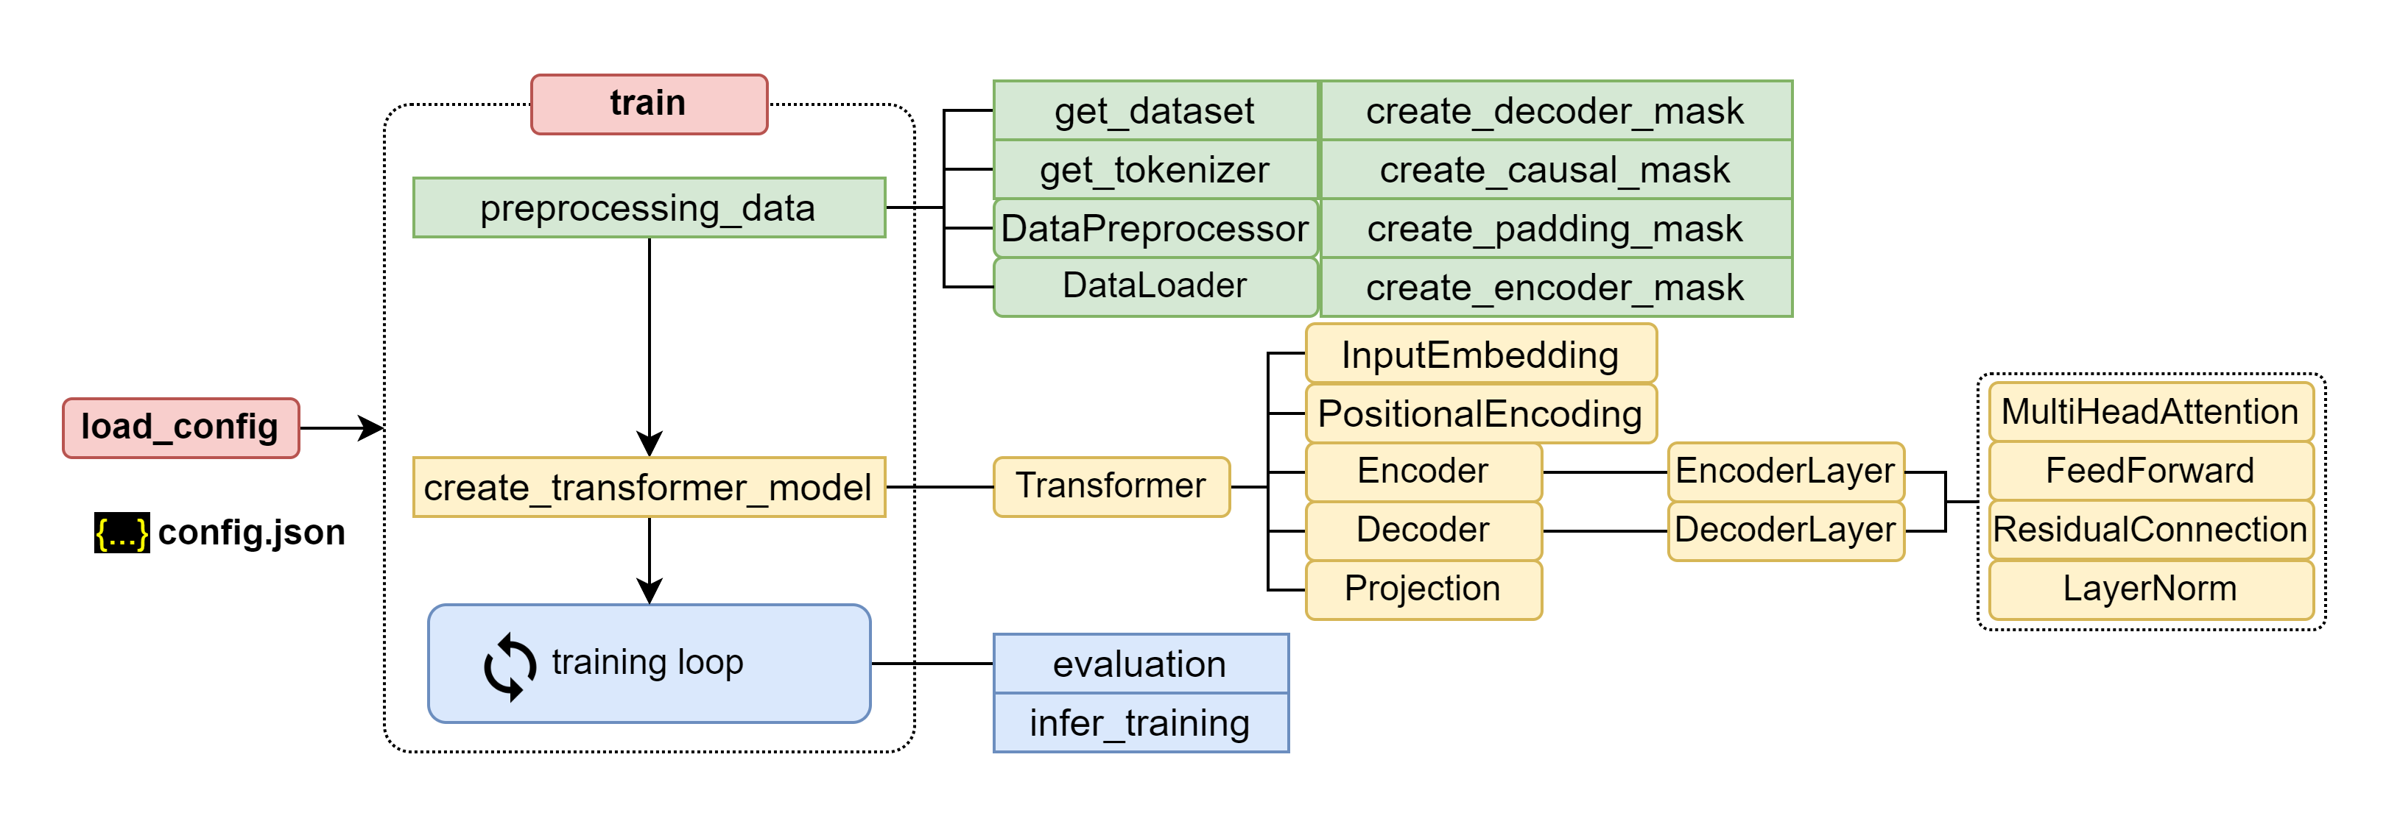
Put it all together

Slide 17
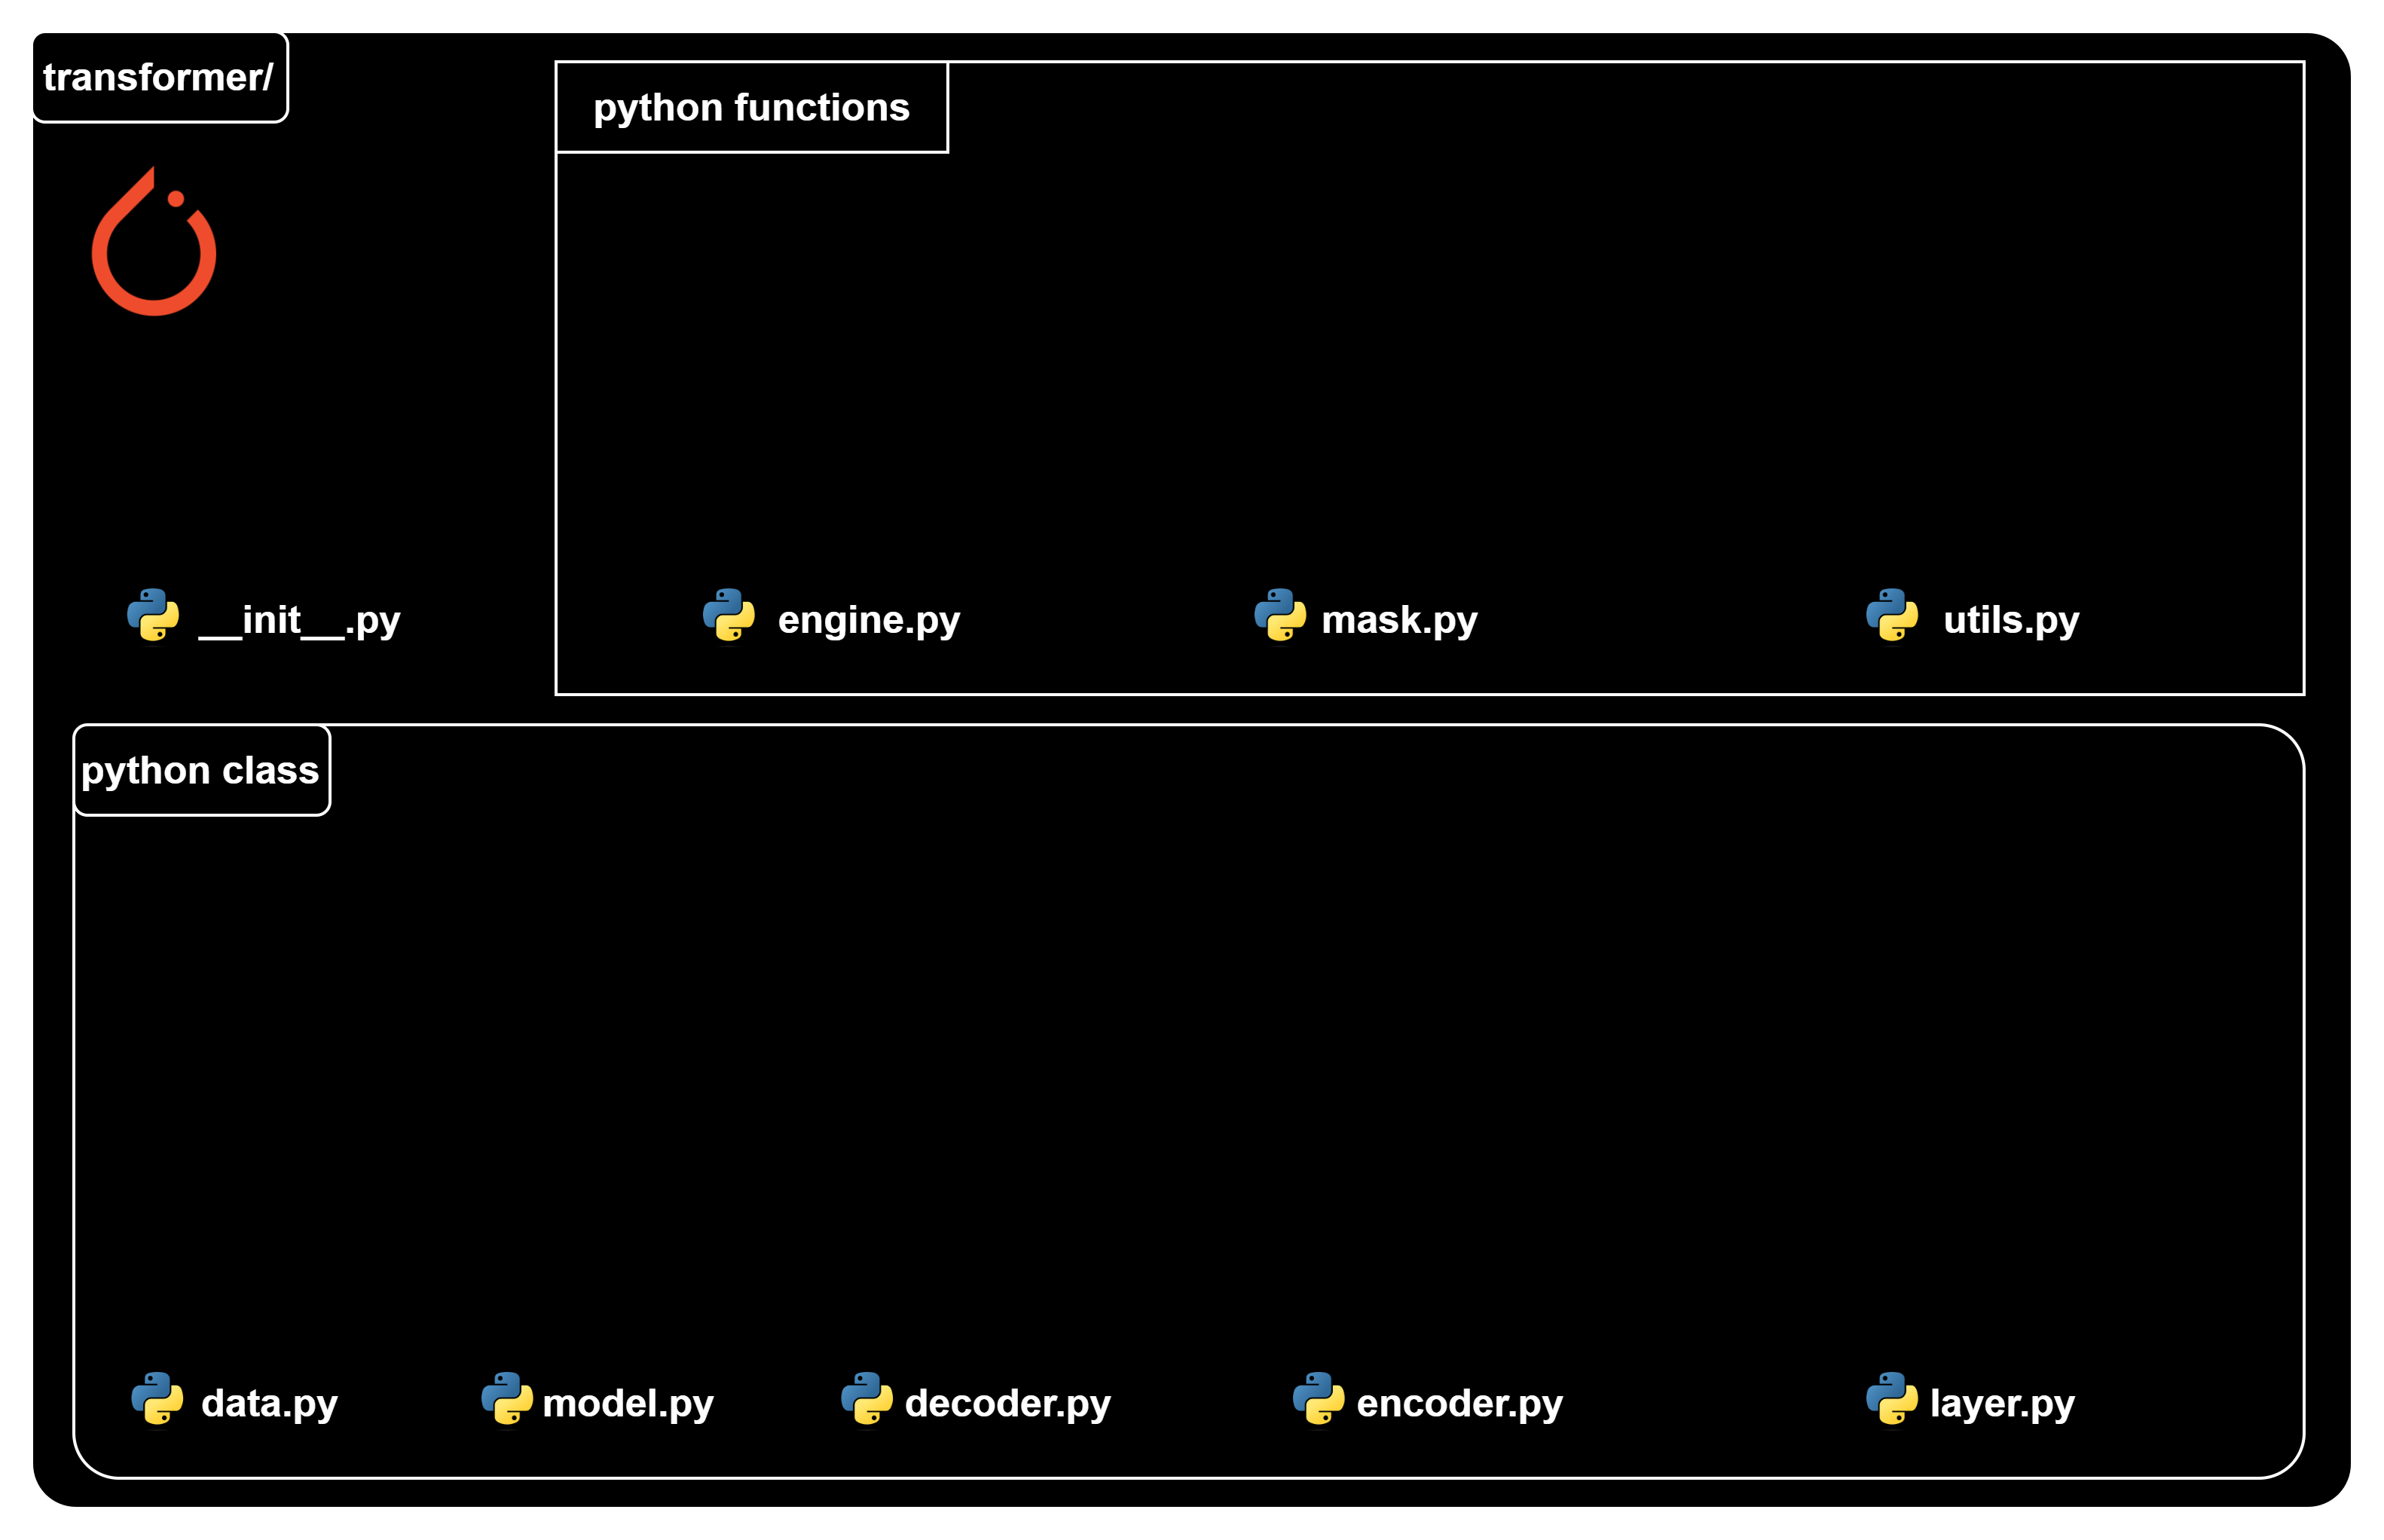
Source code structure

Slide 18
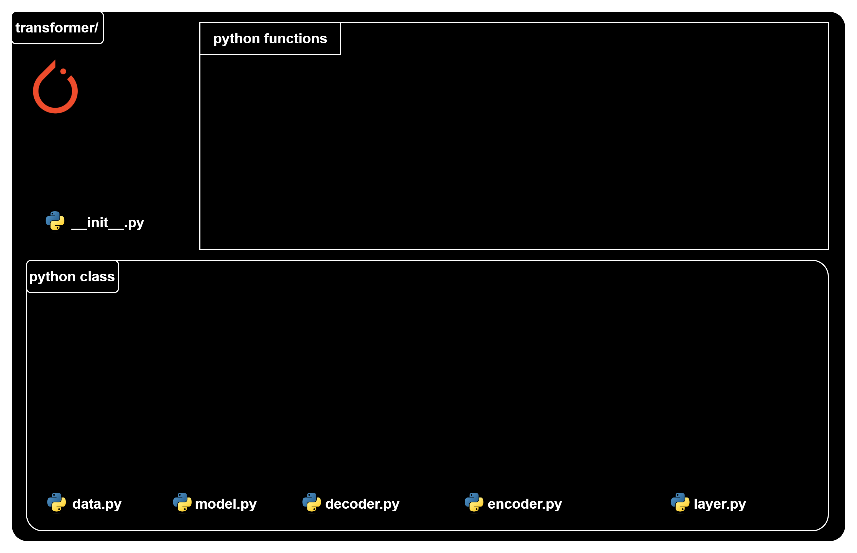
Transformer classes

Slide 19
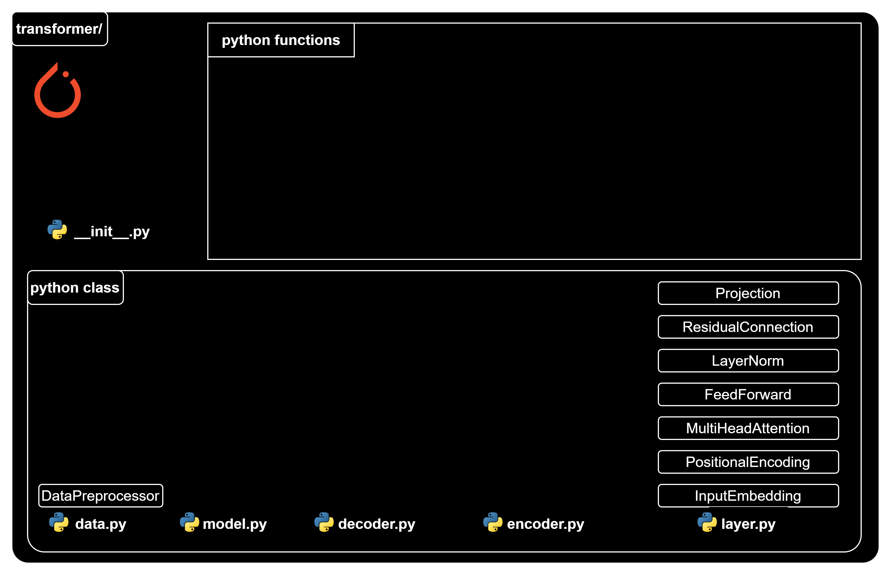
Transformer classes

Slide 20
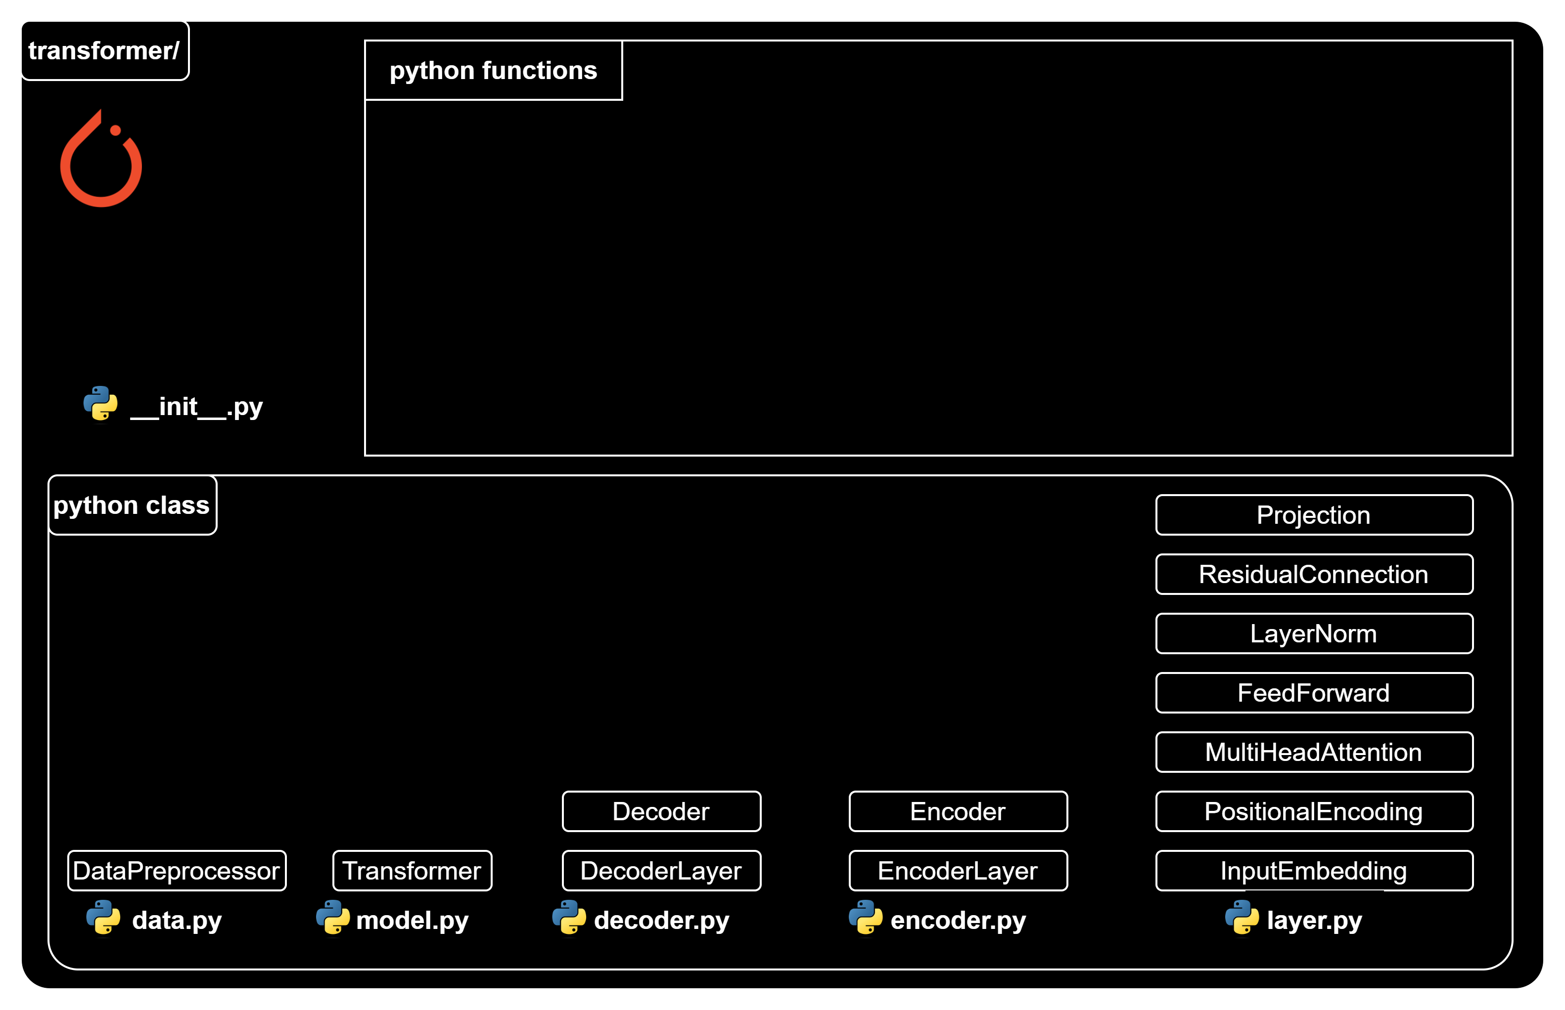
Transformer classes

Slide 21
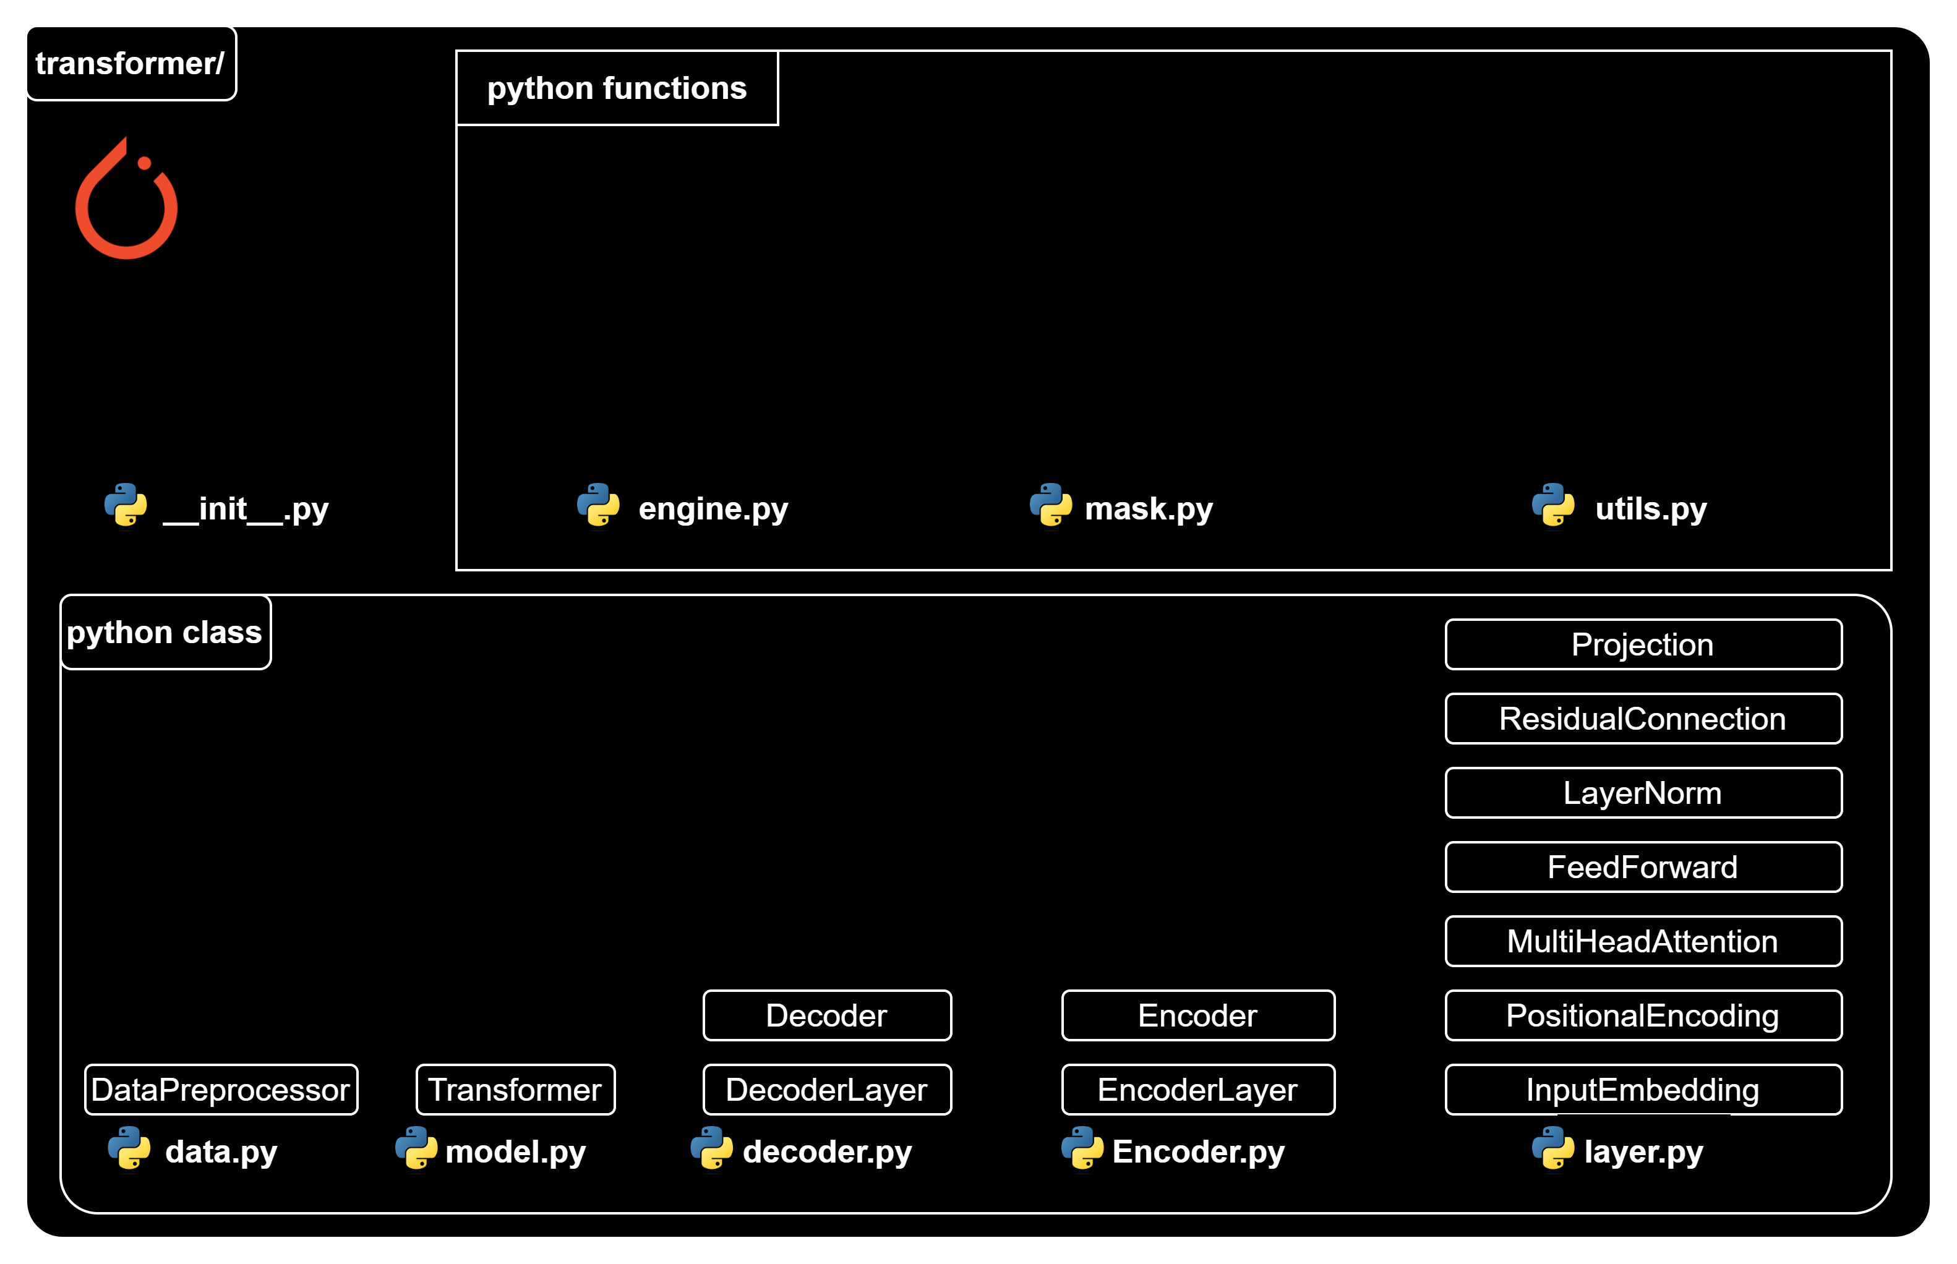
Transformer functions

Slide 22
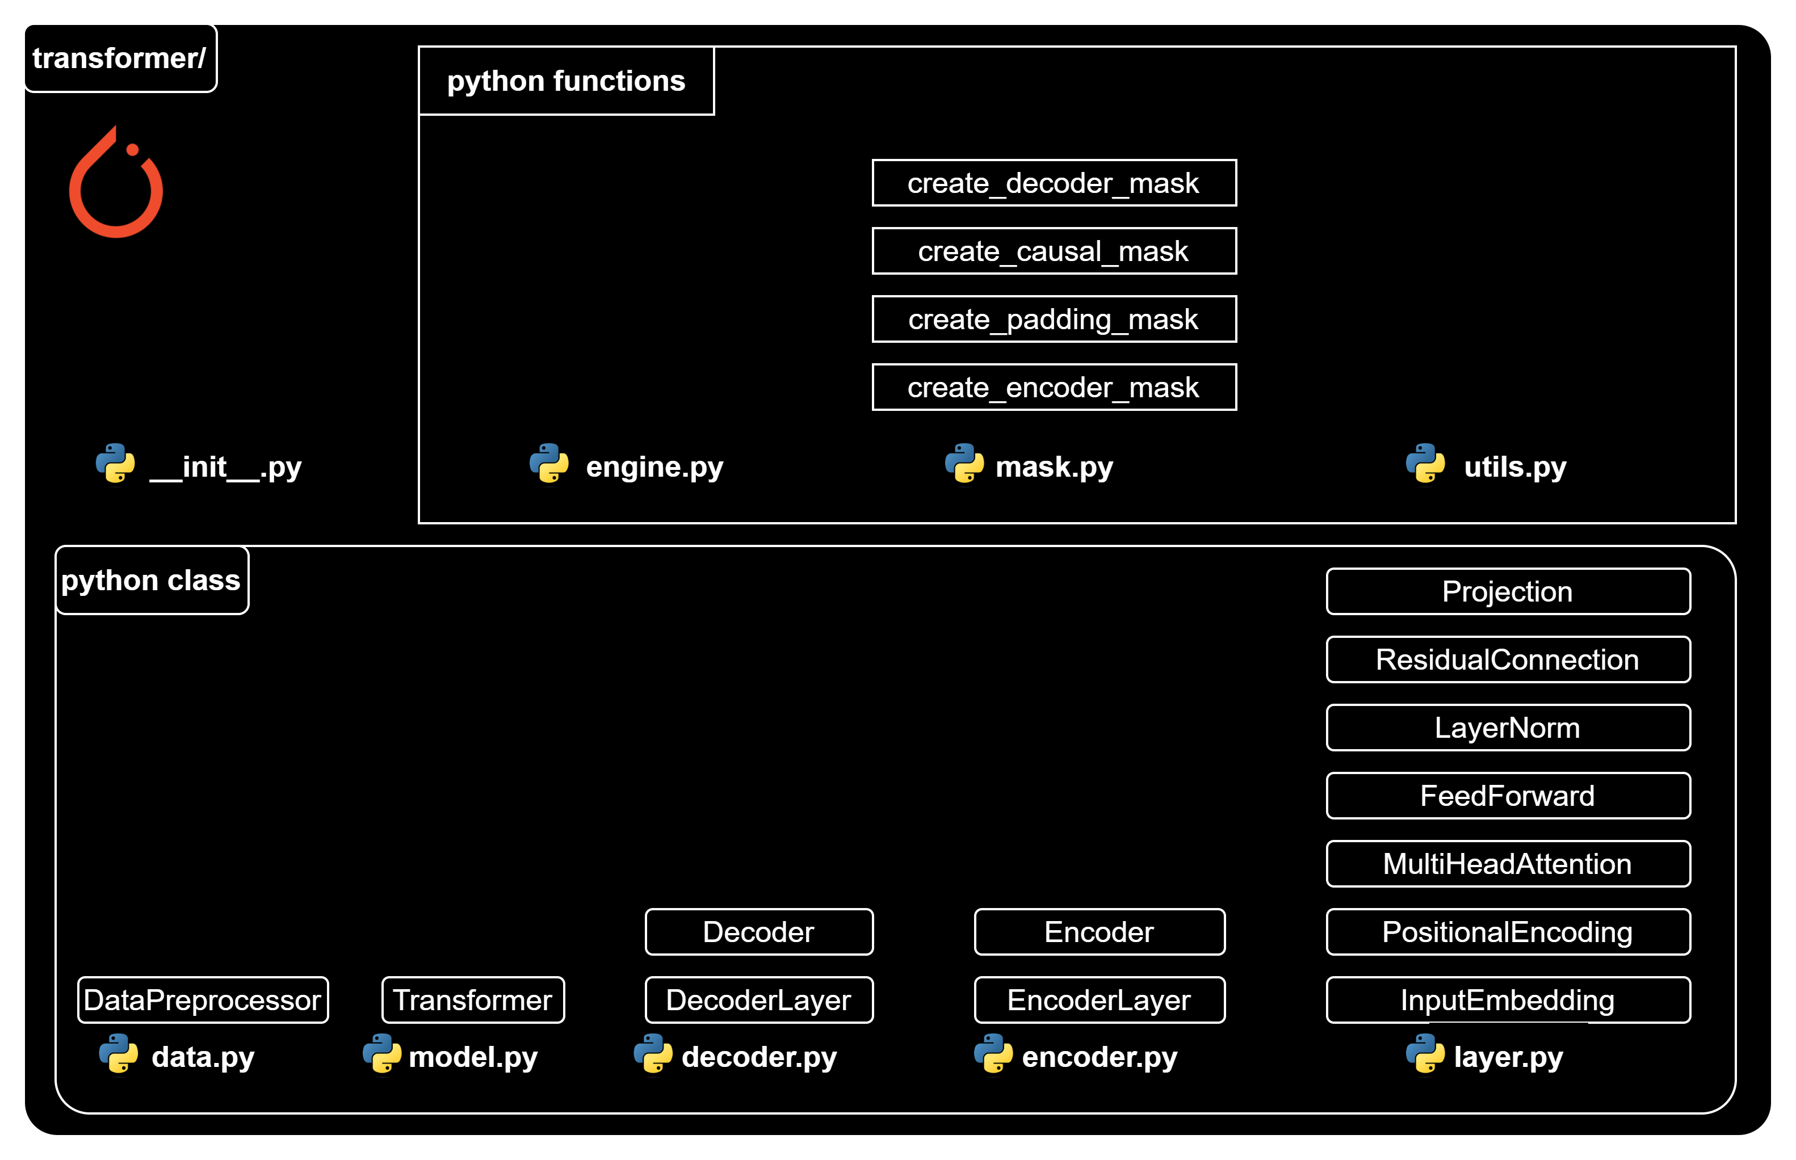
Transformer functions

Slide 23
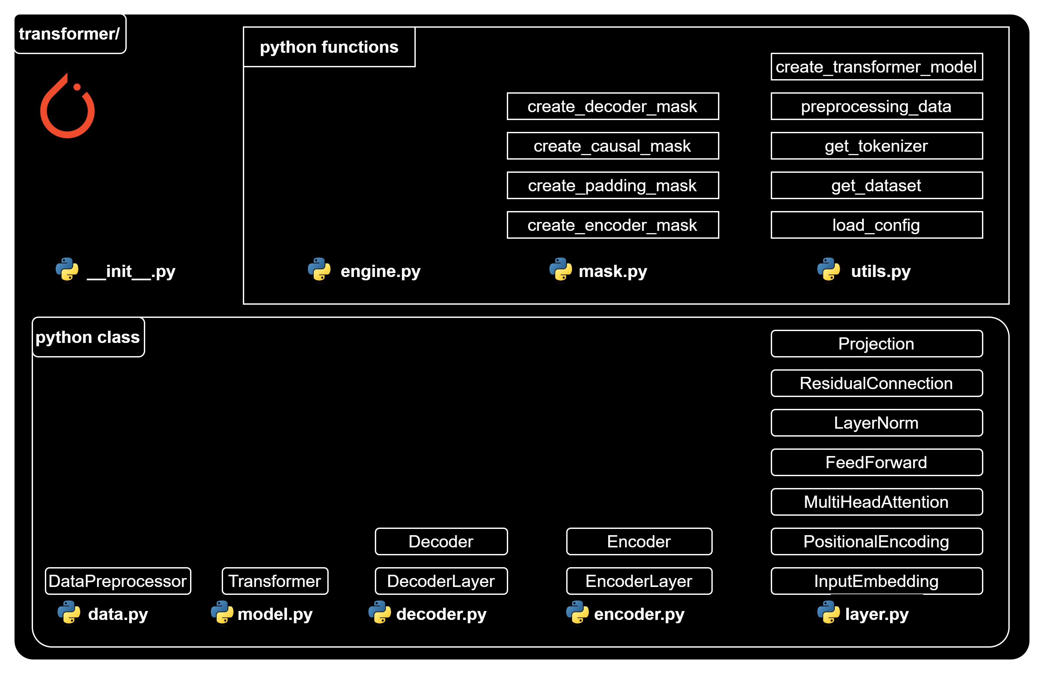
Transformer functions

Slide 24
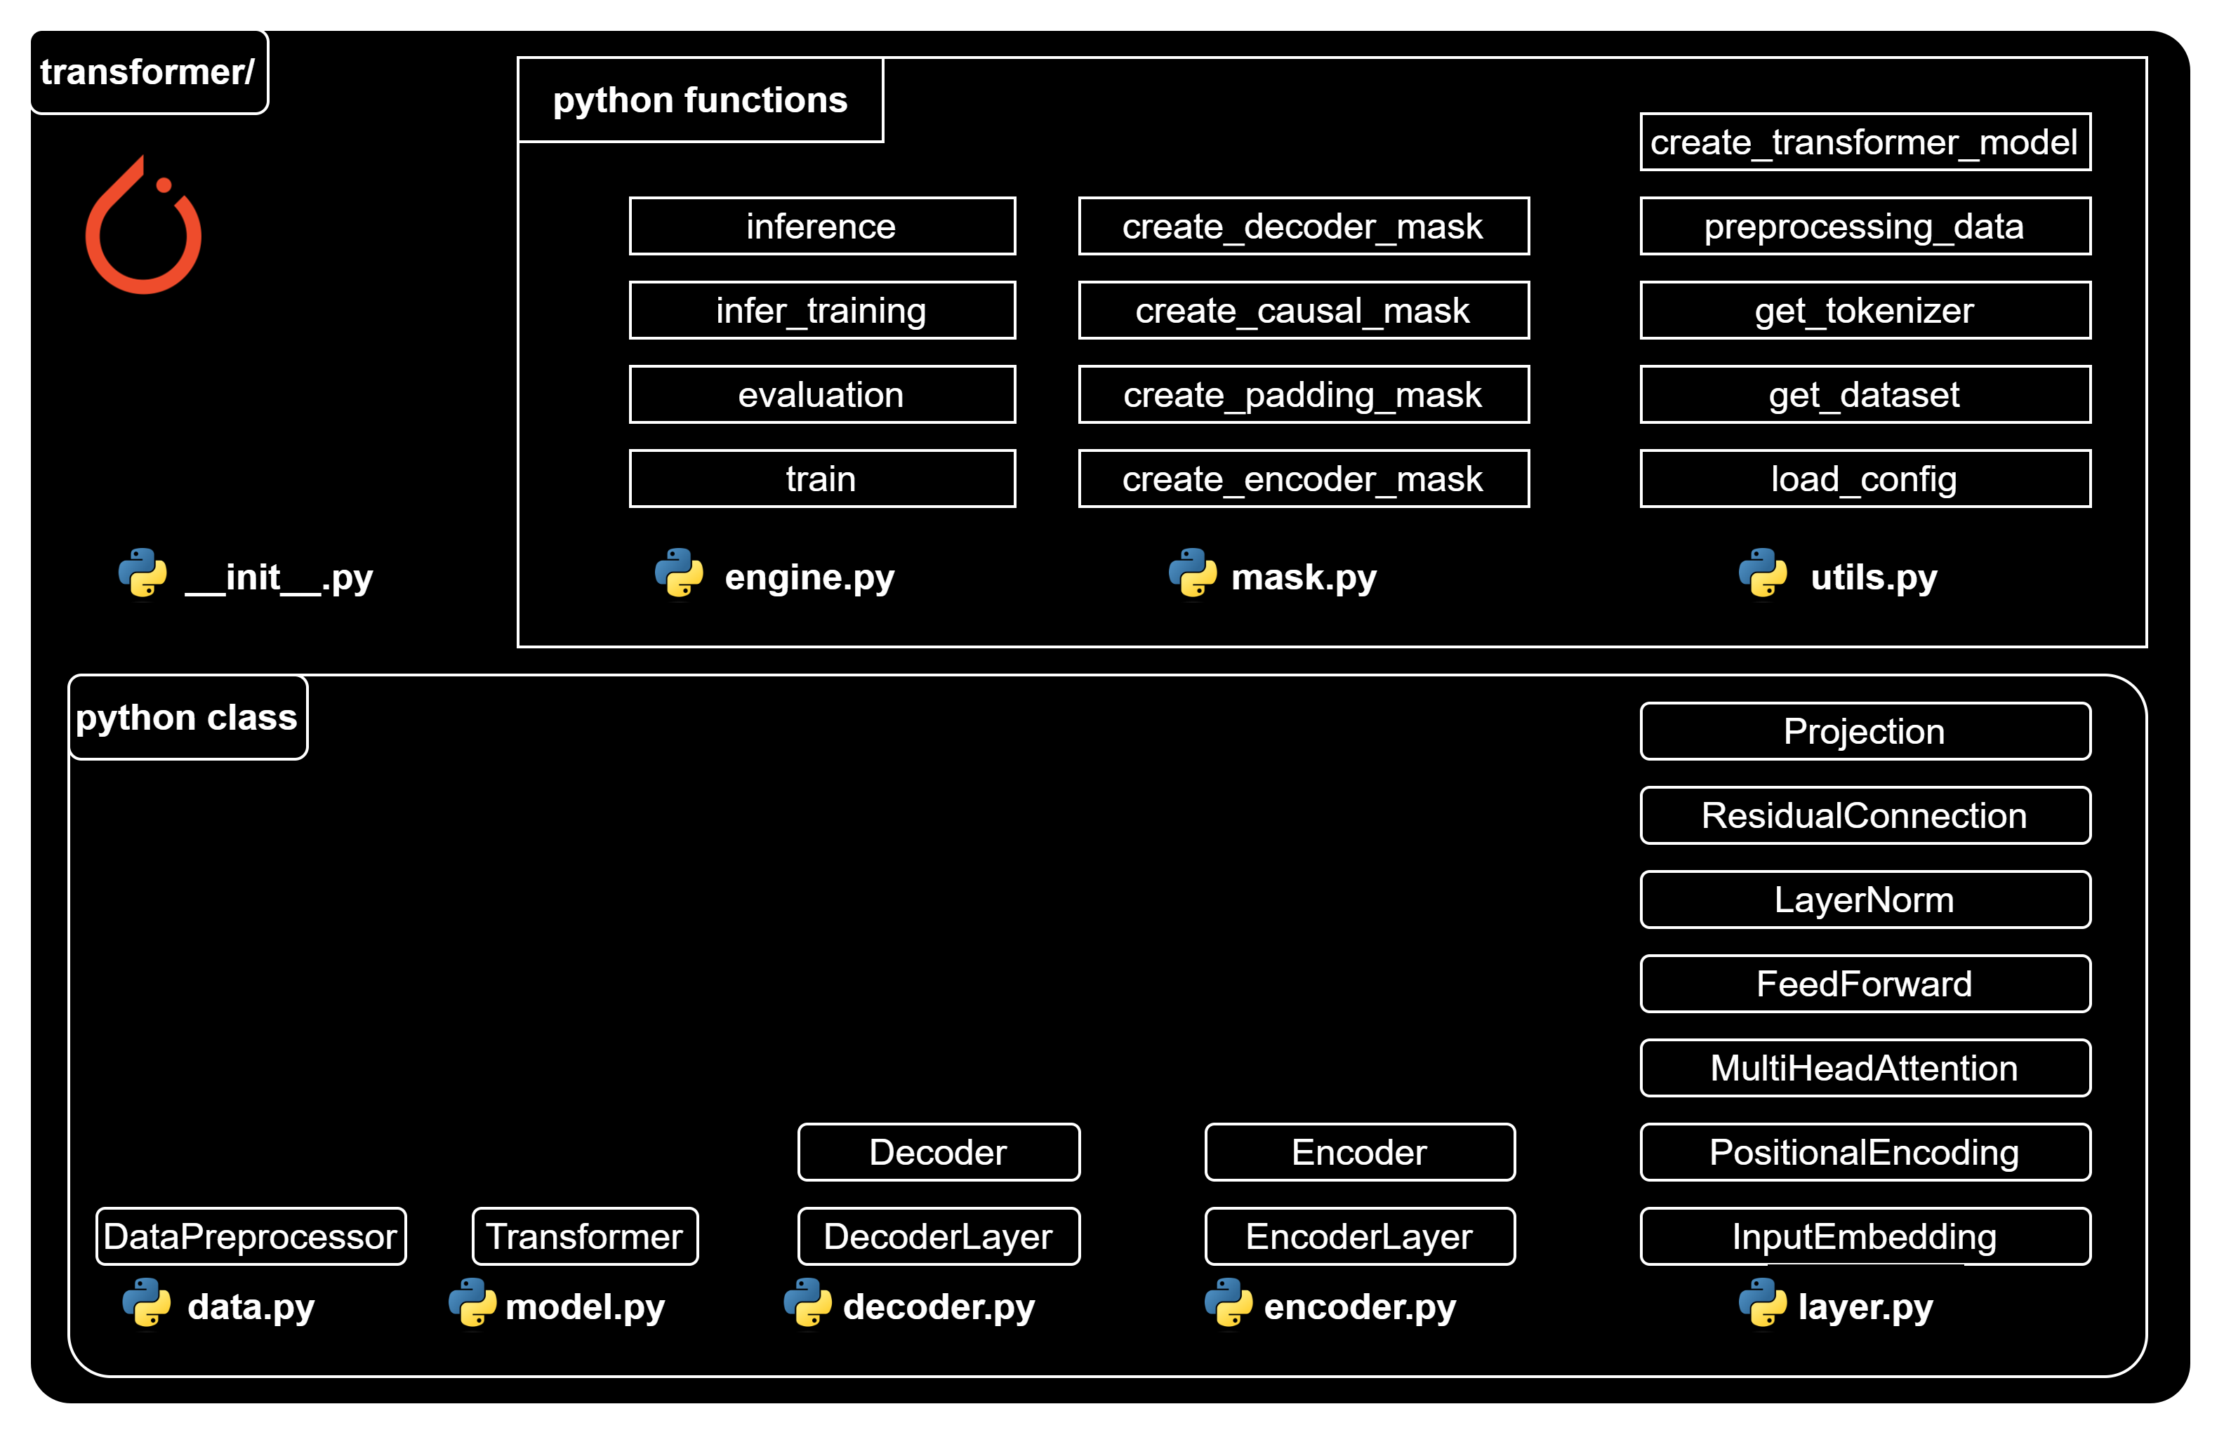
Transformer functions

Slide 27
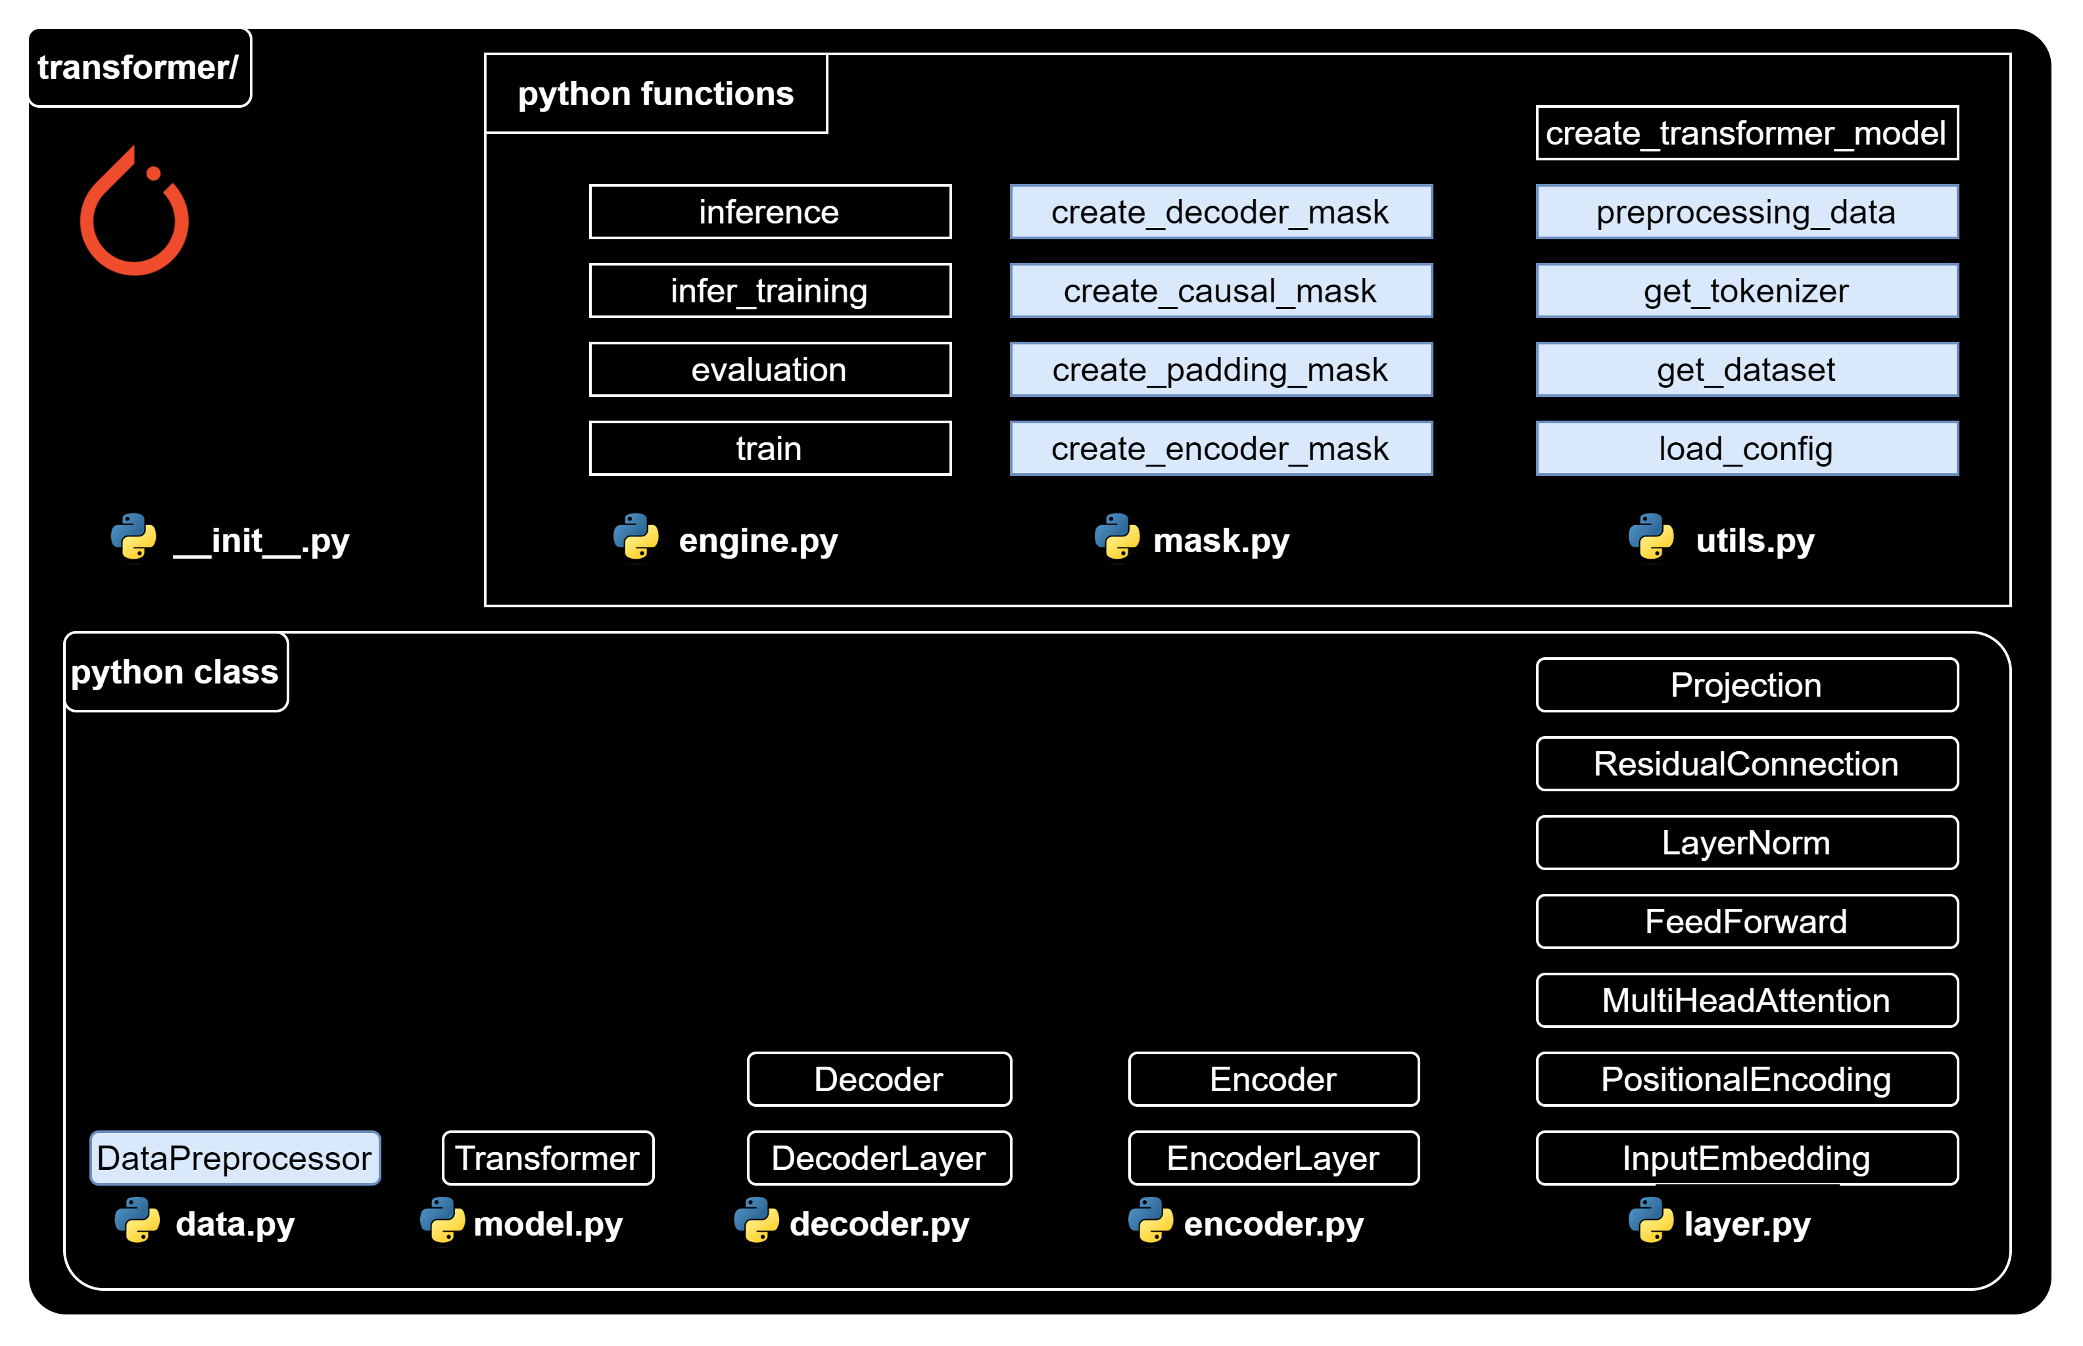
Data preparation function/class

Slide 29
Data preparation function/class

Slide 30

Utils – Load config
utils.py
import json
def load_config(config_file_path):
# Open the file in read mode
with open(config_file_path, "r") as f:
# Load the JSON content of the file into a Python dictionary
config = json.load(f)
# Return the configuration data
return config

Slide 31

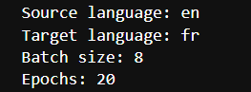
Playground– Load config
nb_load_config.ipynb
{…} config.json
import sys
sys.path.append('../')
from transformer.utils import load_config
config_file_path = "../config.json"
config = load_config(config_file_path)
print("Source language:", config['language_source'])
print("Target language:", config['language_target'])
print("Batch size:", config['batch_size'])
print("Epochs:", config['epochs'])

Slide 33
Data preparation function/class

Slide 34
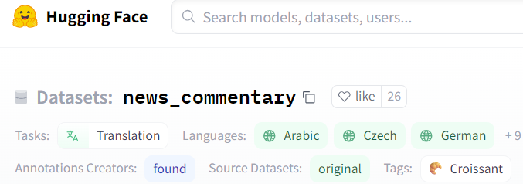
Utils – Get dataset
utils.py
from datasets import load_dataset
def get_dataset(config):
# Extract the dataset name, source language, target language, and split from the config
dataset_name = config["dataset_name"] # “news_commentary”
lang_src = config["language_source"] # “en”
lang_tgt = config["language_target"] # “fr”
split = config["split"] # “train”
# Construct the language pair string
language_pair = f"{lang_src}-{lang_tgt}"
# Load the dataset using the provided parameters
raw_dataset = load_dataset(dataset_name, language_pair, split=split)
# Return the loaded dataset
return raw_dataset

Slide 35
Playground – Get dataset
nb_get_dataset.ipynb
import sys
sys.path.append('../')
from transformer.utils import load_config, get_dataset
## Load config
config_file_path = "../config.json"
config = load_config(config_file_path)
# Load dataset
dataset = get_dataset(config)
print(dataset['translation'][:2])

Slide 37
Data preparation function/class

Slide 38
Utils – Get tokenizer
utils.py
from pathlib import Path
from tokenizers import Tokenizer, models, pre_tokenizers, trainers
def get_tokenizer(config, dataset, language):
# Extract the tokenizer name from the config and construct the tokenizer file path
tokenizer_name = config["tokenizer_name"]
tokenizer_path = f"{tokenizer_name}{language}.json"
# Check if a tokenizer file already exists at the specified path
if Path.exists(Path(tokenizer_path)):
# If it does, load the tokenizer from that file
tokenizer = Tokenizer.from_file(tokenizer_path)
else:
# If it doesn't, create a new tokenizer
tokenizer = Tokenizer(models.WordLevel(unk_token="[UNK]"))
tokenizer.pre_tokenizer = pre_tokenizers.Whitespace()

Slide 39
Utils – Get tokenizer
utils.py
# Create a trainer for the tokenizer
trainer = trainers.WordLevelTrainer(
min_frequency=2,
special_tokens=["[PAD]", "[UNK]", "[SOS]", "[EOS]"],
)
# Train the tokenizer on the provided dataset
tokenizer.train_from_iterator(
(item[language] for item in dataset["translation"]), trainer=trainer
)
# Save the trained tokenizer to the specified path
tokenizer.save(tokenizer_path)
# Return the tokenizer
return tokenizer

Slide 40
Playground – Get tokenizer
nb_get_tokenizer.ipynb
import sys
sys.path.append('../')
from transformer.utils import load_config, get_dataset, get_tokenizer
## Load config
config_file_path = "../config.json"
config = load_config(config_file_path)
# Load dataset
dataset = get_dataset(config)
print(dataset['translation'][:2])
## Load tokenizer
tokenizer_src = get_tokenizer(config, dataset, config['language_source'])
tokenizer_tgt = get_tokenizer(config, dataset, config['language_target'])

Slide 41
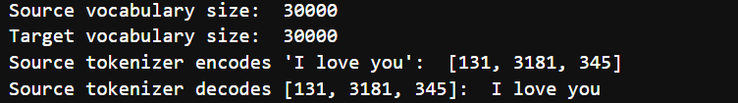
Playground – Get tokenizer
nb_get_tokenizer.ipynb
## Explore tokenizer
# check vocabulary size
print("Source vocabulary size: ", tokenizer_src.get_vocab_size())
print("Target vocabulary size: ", tokenizer_tgt.get_vocab_size())
# Check source tokenizer encodes/decodes
print("Source tokenizer encodes 'I love you': ", tokenizer_src.encode('I love you').ids)
print("Source tokenizer decodes [131, 3181, 345]: ", tokenizer_src.decode([131, 3181, 345]))

Slide 43
Data preparation function/class

Slide 45
Creating mask functions
mask.py
import torch
def create_encoder_mask(encoder_input_ids, pad_token_id):
return (encoder_input_ids != pad_token_id).unsqueeze(0).unsqueeze(0).int()
PAD token id
2
68
72
3
0
0
1
1
1
1
0
0
Encoder input ids
Encoder mask's output

Slide 46
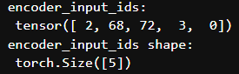
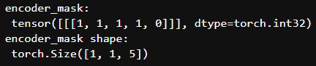
Playground – Create encoder mask
nb_mask.ipynb
import sys
sys.path.append('../')
import torch
from transformer.mask import *
# Create the inputs
en_input_ids = torch.tensor([ 2, 68, 72, 3, 0])
pad_id = torch.tensor([0]) # pad token id
# Create encoder mask
encoder_mask = create_encoder_mask(en_input_ids, pad_id) # (1, 1, seq_len)
print("encoder_input_ids: \n",
encoder_input_ids)
print("encoder_input_ids shape: \n",
encoder_input_ids.shape)
print("encoder_mask: \n", encoder_mask)
print("encoder_mask shape: \n",
encoder_mask.shape)

Slide 48
Creating mask functions
mask.py
import torch
def create_padding_mask(decoder_input_ids, pad_token_id):
return (decoder_input_ids != pad_token_id).unsqueeze(0).int()
PAD token id
2
68
72
3
0
0
1
1
1
1
0
0
Decoder input ids
Padding mask's output

Slide 49
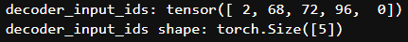
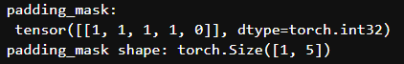
Playground – Create padding mask
nb_mask.ipynb
import sys
sys.path.append('../')
import torch
from transformer.mask import *
# Create the inputs
de_input_ids = torch.tensor([ 2, 68, 72, 96, 0])
pad_id = torch.tensor([0]) # pad token id
# Create padding mask # (1, seq_len)
padding_mask = create_padding_mask(de_input_ids, pad_id)
print("decoder_input_ids:",
decoder_input_ids)
print("decoder_input_ids shape:",
decoder_input_ids.shape)
print("padding_mask: \n", padding_mask)
print("padding_mask shape:", padding_mask.shape)

Slide 51
Creating mask functions
mask.py
import torch
def create_causal_mask(seq_len):
return (torch.triu(torch.ones((1, seq_len, seq_len)), diagonal=1).type(torch.int) == 0)
True
False
False
False
False
True
True
False
False
False
True
True
True
False
False
(1, 5, 5)
seq_len = 5
True
True
True
True
False
True
True
True
True
True
Causal mask's output

Slide 52
Creating mask functions
mask.py
import torch
def create_causal_mask(seq_len):
return (torch.triu(torch.ones((1, seq_len, seq_len)), diagonal=1).type(torch.int) == 0)
1
1
1
1
1
1
1
1
1
1
1
1
1
1
1
1
1
1
1
1
1
1
1
1
1

Slide 53
Creating mask functions
mask.py
import torch
def create_causal_mask(seq_len):
return (torch.triu(torch.ones((1, seq_len, seq_len)), diagonal=1).type(torch.int) == 0)
1
1
1
1
1
0
1
1
1
1
0
0
1
1
1
0
0
0
1
1
0
0
0
0
1

Slide 54
Creating mask functions
mask.py
import torch
def create_causal_mask(seq_len):
return (torch.triu(torch.ones((1, seq_len, seq_len)), diagonal=1).type(torch.int) == 0)
0
1
1
1
1
0
0
1
1
1
0
0
0
1
1
0
0
0
0
1
0
0
0
0
0

Slide 55
Creating mask functions
mask.py
import torch
def create_causal_mask(seq_len):
return (torch.triu(torch.ones((1, seq_len, seq_len)), diagonal=1).type(torch.int) == 0)
True
False
False
False
False
True
True
False
False
False
True
True
True
False
False
(1, 5, 5)
seq_len = 5
True
True
True
True
False
True
True
True
True
True
Causal mask's output

Slide 56
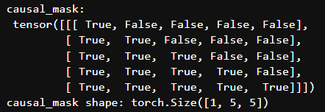
Playground – Create causal mask
nb_mask.ipynb
import sys
sys.path.append('../')
import torch
from transformer.mask import *
# Create the inputs
seq_len = 5 # sequence length
# Create a causal mask # (1, seq_len, seq_len)
causal_mask = create_causal_mask(seq_len)
print('causal_mask: \n', causal_mask)
print('causal_mask shape:', causal_mask.shape)

Slide 58
Creating mask functions
mask.py
import torch
def create_decoder_mask(decoder_input_ids, pad_token_id, seq_len):
padding_mask = create_padding_mask(decoder_input_ids, pad_token_id)
causal_mask = create_causal_mask(seq_len)
return padding_mask & causal_mask

Slide 59
Creating mask functions
mask.py
import torch
def create_decoder_mask(decoder_input_ids, pad_token_id, seq_len):
padding_mask = create_padding_mask(decoder_input_ids, pad_token_id)
causal_mask = create_causal_mask(seq_len)
return padding_mask & causal_mask
2
68
72
3
0
Decoder input ids
1
1
1
1
0
Padding mask's output

Slide 60
Creating mask functions
mask.py
import torch
def create_decoder_mask(decoder_input_ids, pad_token_id, seq_len):
padding_mask = create_padding_mask(decoder_input_ids, pad_token_id)
causal_mask = create_causal_mask(seq_len)
return padding_mask & causal_mask
2
68
72
3
0
True
False
False
False
False
True
True
False
False
False
Decoder input ids
True
True
True
False
False
1
1
1
1
0
True
True
True
True
False
True
True
True
True
True
Padding mask's output
Causal mask's output

Slide 61
Creating mask functions
mask.py
import torch
def create_decoder_mask(decoder_input_ids, pad_token_id, seq_len):
padding_mask = create_padding_mask(decoder_input_ids, pad_token_id)
causal_mask = create_causal_mask(seq_len)
return padding_mask & causal_mask
2
68
72
3
0
True
False
False
False
False
1
0
0
0
0
True
True
False
False
False
1
1
0
0
0
Decoder input ids
True
True
True
False
False
1
1
1
0
0
1
1
1
1
0
True
True
True
True
False
1
1
1
1
0
&
=
True
True
True
True
True
1
1
1
1
0
Padding mask's output
Causal mask's output
Decoder mask's output

Slide 62
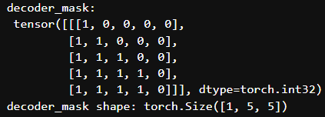
Playground – Create decoder mask
nb_mask.ipynb
import sys
sys.path.append('../')
import torch
from transformer.mask import *
# Create the inputs
de_input_ids = torch.tensor([ 2, 68, 72, 96, 0])
pad_id = torch.tensor([0]) # pad token id
seq_len = 5 # sequence length
# Create decoder mask # (1, seq_len, seq_len)
decoder_mask = create_decoder_mask(de_input_ids, pad_id, seq_len)
print("decoder_input_ids:",
decoder_input_ids)
print("decoder_input_ids shape:",
decoder_input_ids.shape)
print('decoder_mask: \n', decoder_mask)
print('decoder_mask shape:', decoder_mask.shape)

Slide 64
Data preparation function/class

Slide 65
Data – Data Preprocessor class
data.py
import torch
from torch.utils.data import Dataset
from transformer.mask import create_encoder_mask, create_decoder_mask
class DataPreprocessor(Dataset):
def __init__(self, dataset, tokenizer_src, tokenizer_tgt, language_src, language_tgt, seq_len):
super().__init__()
# Store the parameters.
self.dataset = dataset
self.tokenizer_src = tokenizer_src
self.tokenizer_tgt = tokenizer_tgt
self.language_src = language_src
self.language_tgt = language_tgt
self.seq_len = seq_len

Slide 66
Data – Data Preprocessor class
data.py
# Get the token ids for the special tokens.
self.sos_token_id = torch.tensor([self.tokenizer_src.token_to_id('[SOS]')], dtype=torch.int64)
self.eos_token_id = torch.tensor([self.tokenizer_src.token_to_id('[EOS]')], dtype=torch.int64)
self.pad_token_id = torch.tensor([self.tokenizer_src.token_to_id('[PAD]')], dtype=torch.int64)
# The __len__ method returns the number of items in the dataset.
def __len__(self):
return len(self.dataset)

Slide 67
Data – Data Preprocessor class
data.py
# The __getitem__ method returns the preprocessed data for the item at the given index.
def __getitem__(self, idx):
# Get the item from the dataset.
item = self.dataset[idx]
# Get the source and target texts from the item.
text_src = item['translation'][self.language_src]
text_tgt = item['translation'][self.language_tgt]
# Tokenize the source and target texts.
encoder_token_ids = torch.tensor(self.tokenizer_src.encode(text_src).ids, dtype=torch.int64)
decoder_token_ids = torch.tensor(self.tokenizer_tgt.encode(text_tgt).ids, dtype=torch.int64)
# Calculate the number of padding tokens needed for the encoder and decoder inputs.
encoder_padding_num = self.seq_len - len(encoder_token_ids) - 2 # 2: SOS & EOS
decoder_padding_num = self.seq_len - len(decoder_token_ids) - 1 # 1: SOS

Slide 68
Data – Data Preprocessor class
data.py
# Create the encoder and decoder inputs and the decoder target.
encoder_input_ids = torch.cat(
[
self.sos_token_id,
encoder_token_ids,
self.eos_token_id,
self.pad_token_id.repeat(encoder_padding_num),
])
decoder_input_ids = torch.cat(
[
self.sos_token_id,
decoder_token_ids,
self.pad_token_id.repeat(decoder_padding_num),
])
decoder_target_ids = torch.cat(
[
decoder_token_ids,
self.eos_token_id,
self.pad_token_id.repeat(decoder_padding_num),
]) # (seq_len)

Slide 69
Data – Data Preprocessor class
data.py
# Create the masks for the encoder and decoder inputs, (1, 1, seq_len)
encoder_mask = create_encoder_mask(encoder_input_ids, self.pad_token_id)
# Create the masks for the decoder inputs (1, seq_len, seq_len)
decoder_mask = create_decoder_mask(decoder_input_ids, self.pad_token_id, self.seq_len)
# Return the preprocessed data.
output = {
"text_src": text_src,
"text_tgt": text_tgt,
"encoder_input_ids": encoder_input_ids,
"decoder_input_ids": decoder_input_ids,
"decoder_target_ids": decoder_target_ids,
"encoder_mask": encoder_mask,
"decoder_mask": decoder_mask
}
return output

Slide 71
Data preparation function/class

Slide 72
Utils – Preprocessing data
utils.py
def preprocessing_data(config):
# Get the raw dataset
raw_dataset = get_dataset(config)
# Initialize tokenizers for the source & target languages
tokenizer_src = get_tokenizer(config, raw_dataset, config["language_source"])
tokenizer_tgt = get_tokenizer(config, raw_dataset, config["language_target"])
# Calculate the sizes of the training, validation, and test sets
train_ds_size = int(len(raw_dataset) * 0.7)
val_ds_size = int(len(raw_dataset) * 0.2)
test_ds_size = len(raw_dataset) - train_ds_size - val_ds_size
# Split the raw dataset into training, validation, and test sets
train_raw_dataset, val_raw_dataset, test_raw_dataset = random_split(raw_dataset, [train_ds_size, val_ds_size, test_ds_size])

Slide 73
Utils – Preprocessing data
utils.py
# Preprocess the training, validation, and test sets
train_ds = DataPreprocessor(
train_raw_dataset, tokenizer_src, tokenizer_tgt,
config["language_source"],
config["language_target"],
config["seq_len"],)
val_ds = DataPreprocessor(
val_raw_dataset, tokenizer_src, tokenizer_tgt,
config["language_source"],
config["language_target"],
config["seq_len"],)
test_ds = DataPreprocessor(
test_raw_dataset, tokenizer_src, tokenizer_tgt,
config["language_source"],
config["language_target"],
config["seq_len"],)

Slide 74
Utils – Preprocessing data
utils.py
# Create DataLoaders for the training, validation, and test sets
train_dataloader = DataLoader(train_ds, batch_size=config["batch_size"], shuffle=True)
val_dataloader = DataLoader(val_ds, batch_size=1, shuffle=True)
test_dataloader = DataLoader(test_ds, batch_size=1, shuffle=True)
return (
train_dataloader,
val_dataloader,
test_dataloader,
tokenizer_src,
tokenizer_tgt,
)

Slide 76
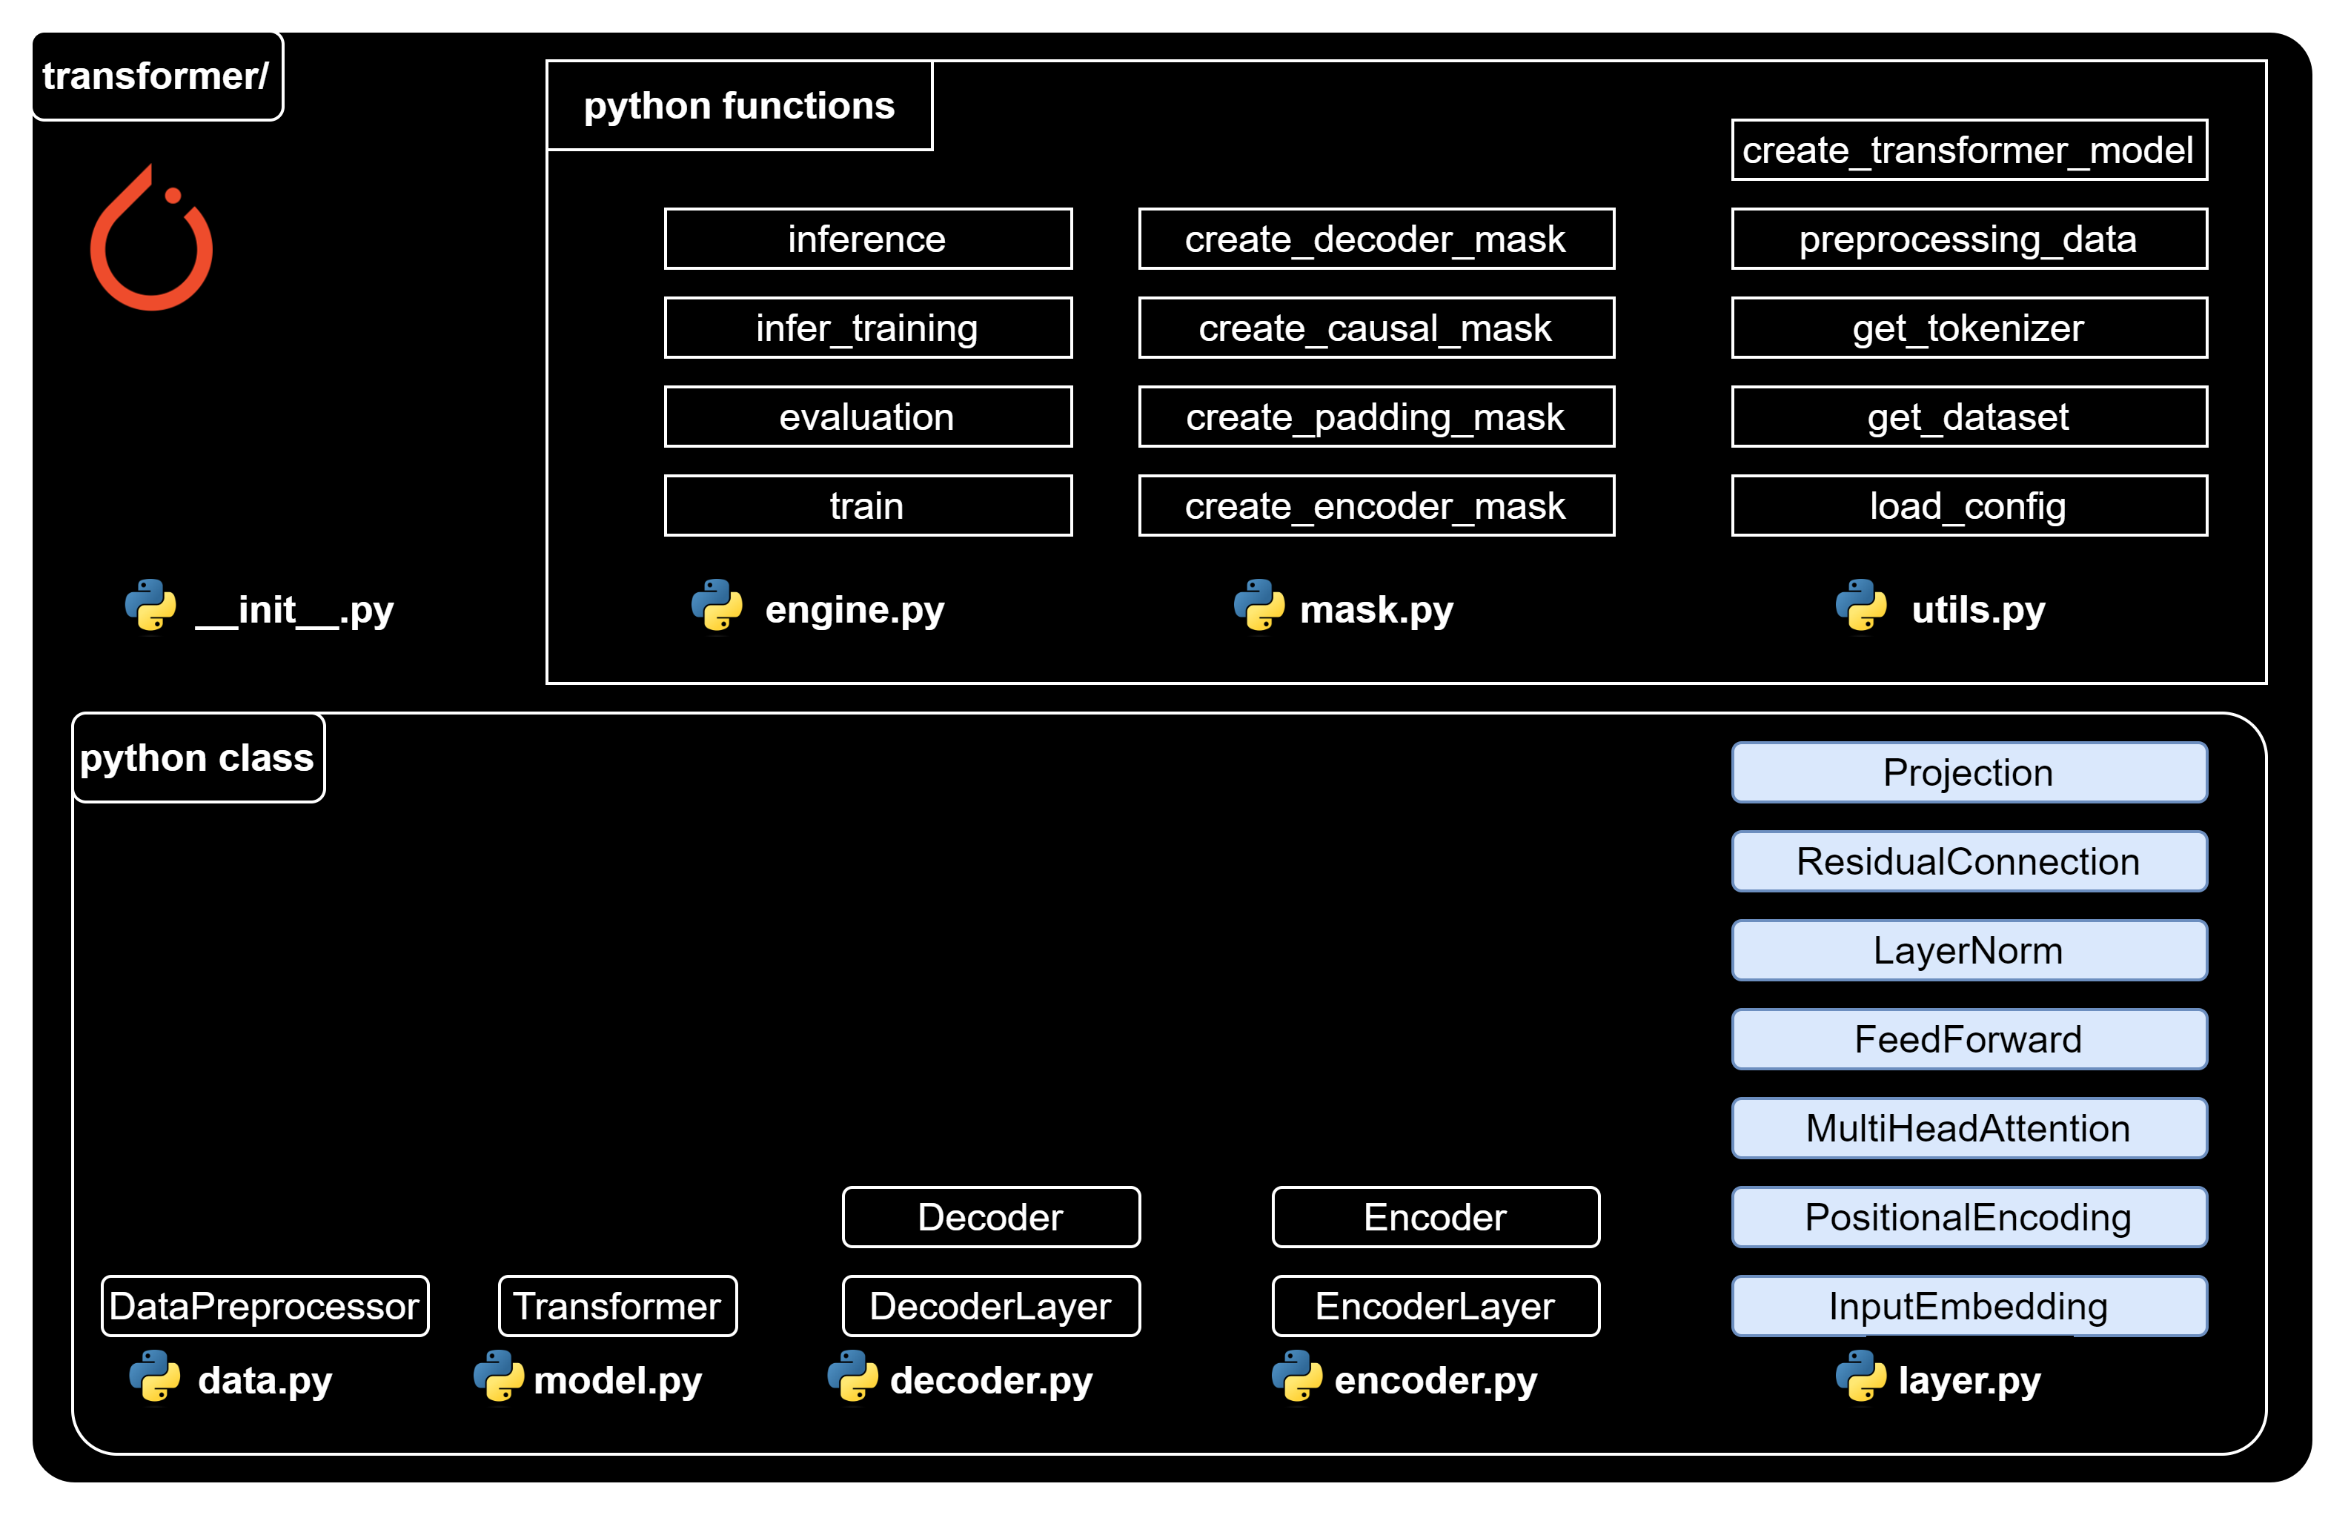
Transformer building block

Slide 78
Transformer building block

Slide 79
Layer – Input Embedding
layer.py
import torch
import torch.nn as nn
import math
class InputEmbedding(nn.Module):
def __init__(self, vocab_size, d_model):
super().__init__()
self.embedding = nn.Embedding(vocab_size, d_model)
self.d_model = d_model
def forward(self, x): # x: [batch_size, seq_len]
# Apply the embedding layer to the input,
# and then scales the result by the square root of the embedding dimensionality.
return self.embedding(x) * math.sqrt(self.d_model) # [batch_size, seq_len, d_model].

Slide 80
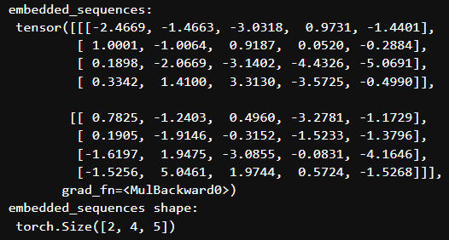
Layer – Input Embedding
nb_input_embedding.ipynb
import sys
sys.path.append('../')
import torch
from transformer.layer import InputEmbedding
# Initiate parammeters
vocab_size = 10
d_model = 5
# Create an instance of our InputEmbedding class
input_embedding = InputEmbedding(vocab_size, d_model)
# Suppose a batch of 2 sequences
sequences = torch.tensor([[1, 2, 3, 4], [5, 6, 7, 8]])
# Pass our sequences through the input embedding
embedded_sequences = input_embedding(sequences)
print("embedded_sequences: \n", embedded_sequences)
print("embedded_sequences shape: \n", embedded_sequences.shape)

Slide 82
Transformer building block

Slide 83
Layer – Positional Encoding
layer.py
import torch
import torch.nn as nn
class PositionalEncoding(nn.Module):
def __init__(self, d_model: int, seq_len: int, dropout: float) -> None:
super().__init__()
self.dropout = nn.Dropout(dropout)
# Compute the positional encodings once in log space.
position = torch.arange(0, seq_len, dtype=torch.float).unsqueeze(1)
base = 10000.0 ** (-1.0 / d_model)
div_term = torch.pow(base, torch.arange(0, d_model, 2).float()) # Compute the positional encodings
pe = torch.zeros(seq_len, d_model)
pe[:, 0::2] = torch.sin(position * div_term)
pe[:, 1::2] = torch.cos(position * div_term)
pe = pe.unsqueeze(0) # Register the positional encodings as a buffer.
self.register_buffer("pe", pe)

Slide 84
Layer – Positional Encoding
layer.py
def forward(self, x): # x(embeded sequence): [batch_size, seq_len, d_model]
# Add the positional encodings to the input embeddings,
# Then apply dropout to the result.
x = x + (self.pe[:, : x.shape[1], :]).requires_grad_(False)
# self.pe[:, :x.shape[1], :] is to adapt the shape of decoder input in case of training or inference
return self.dropout(x) # [batch_size, seq_len, d_model].

Slide 85
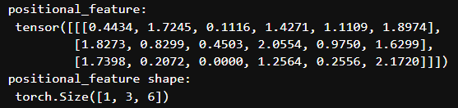
Layer – Positional Encoding
nb_positional_encoding.ipynb
import sys
sys.path.append('../')
import torch
from transformer.layer import PositionalEncoding
# Initiate parammeters
seq_len = 3
d_model = 6
batch_size = 1
dropout = 0.1
# Create an instance of our PositionalEncoding class
pos_encoding = PositionalEncoding(d_model, seq_len, dropout)
# Create a random embedded sequence
torch.manual_seed(68) # for reproducible result
x = torch.rand(batch_size, seq_len, d_model)
# Pass our sequences through the positional encoding
positional_feature = pos_encoding(x)
print("positional_feature: \n", positional_feature)
print("positional_feature shape: \n", positional_feature.shape)

Slide 87
Transformer building block

Slide 88
Layer – Multi Head Attention
layer.py
import torch
import torch.nn as nn
class MultiHeadAttention(nn.Module):
def __init__(self, d_model: int, h: int, dropout: float) -> None:
super().__init__()
self.d_model = d_model
self.h = h # Ensure that the embedding dimensionality is divisible by the number of heads.
assert d_model % h == 0, "d_model % num_heads should be zero"
self.d_k = d_model // h
# Initialize the linear transformations for the queries, keys, values, and output.
self.w_q = nn.Linear(d_model, d_model, bias=False)
self.w_k = nn.Linear(d_model, d_model, bias=False)
self.w_v = nn.Linear(d_model, d_model, bias=False)
self.w_o = nn.Linear(d_model, d_model, bias=False) # Initialize the dropout layer.
self.dropout = nn.Dropout(dropout)

Slide 89
Layer – Multi Head Attention
layer.py
# The attention function calculates the attention scores for a given query, key, and value.
@staticmethod
def attention(query_k, key_k, value_k, d_k, mask=None, dropout=nn.Dropout):
# query_k | key_k | value_k: [batch_size, h, seq_len, d_k]
# mask: [batch_size, 1, seq_len, seq_len]
# Calculate the attention scores.
attention_score = (query_k @ key_k.transpose(-2, -1)) / math.sqrt(d_k)
# Apply the mask, if provided.
if mask is not None:
attention_score = attention_score.masked_fill(mask == 0, -1e9)
# Apply the softmax and dropout function to the attention scores.
attention_score = torch.softmax(attention_score, dim=-1)
attention_score = dropout(attention_score)
# Return the weighted sum of the values, along with the attention scores.
# [batch_size, h, seq_len, d_k], [batch_size, h, seq_len, seq_len]
return (attention_score @ value_k, attention_score)

Slide 90
Layer – Multi Head Attention
layer.py
# The forward method is called when we pass input data into this layer.
def forward(self, query, key, value, mask=None):
# query | key | value: [batch_size, seq_len, d_model]
# mask: [batch_size, 1, seq_len, seq_len]
# Apply the linear transformations to the query, key, and value.
query_k = self.w_q(query)
key_k = self.w_k(key)
value_k = self.w_v(value)
# Reshape and transpose the queries, keys, and values
query_k = query_k.view(query_k.shape[0], query_k.shape[1], self.h, self.d_k).transpose(1, 2)
key_k = key_k.view(key_k.shape[0], key_k.shape[1], self.h, self.d_k).transpose(1, 2)
value_k = value_k.view(value_k.shape[0], value_k.shape[1], self.h, self.d_k).transpose(1, 2)

Slide 91
Layer – Multi Head Attention
layer.py
# Calculate the attention.
attention, _ = self.attention(query_k, key_k, value_k, self.d_k, mask, self.dropout)
# Concatenate the attention heads.
# [batch_size, h, seq_len, d_k] -> [batch_size, seq_len, h, d_k] -> [batch_size, seq_len, d_model]
attention = (attention.transpose(1, 2)
.contiguous()
.view(attention.shape[0], -1, self.d_model)
)
# Apply the output linear transformation and return the result.
return self.w_o(attention) # [batch_size, seq_len, d_model]

Slide 93
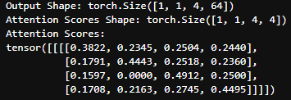
Attention without mask
nb_attention.ipynb
import sys
sys.path.append('../')
import torch
from transformer.layers import MultiHeadAttention
# Configuration setting
batch_size = 1
h = 1
seq_len = 4
d_k = 64
input_tensor = torch.rand(batch_size, h, seq_len, d_k)
query_k = input_tensor.clone()
key_k = input_tensor.clone()
value_k = input_tensor.clone()
# Call the attention function
output, attention_scores = MultiHeadAttention.attention(query_k, key_k, value_k, d_k, mask=None, dropout=nn.Dropout(0.1))
print(f"Output Shape: {output.shape}")
print(f"Attention Scores Shape: {attention_scores.shape}")
print(f"Attention Scores:\n{attention_scores}")

Slide 94
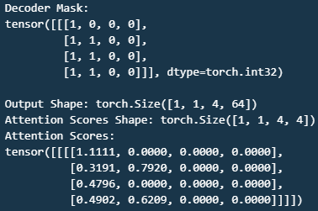
Attention with mask
nb_attention.ipynb
import torch
import torch.nn as nn
from transformer.layers import MultiHeadAttention
from transformer.mask import create_decoder_mask
# Configuration setting
batch_size = 1
h = 1
seq_len = 4
d_k = 64
# Initialize input tensors
torch.manual_seed(68) # for reproducible result input_tensor = torch.rand(batch_size, h, seq_len, d_k)
query_k = input_tensor.clone()
key_k = input_tensor.clone()
value_k = input_tensor.clone()
# Create decoder mask
decoder_input_ids = torch.tensor([ 2, 68, 0, 0])
pad_token_id = torch.tensor([0]) # padding token ID
decoder_mask = create_decoder_mask(decoder_input_ids, pad_token_id, seq_len)
# Call the attention function
output, attention_scores = MultiHeadAttention.attention(query_k, key_k, value_k, d_k, mask=decoder_mask, dropout=nn.Dropout(0.1))
print(…)

Slide 95
Layer – Multi Head Attention
nb_multi_head_attention.ipynb
import sys
sys.path.append('../')
import torch
from transformer.layer import MultiHeadAttention
# Initiate config
batch_size=1
seq_len=5
d_model = 6
h = 3
dropout = 0.1
# Create an instance of the MultiHeadAttention class
multi_head_attention = MultiHeadAttention(d_model, h, dropout)
# Create random tensors
torch.manual_seed(68) # for reproducible result
input_tensor = torch.rand(batch_size, seq_len, d_model)
# query, key, value.
query = input_tensor.clone()
key = input_tensor.clone()
value = input_tensor.clone()
# Call multi-head attention layer
attention = multi_head_attention(query, key, value)
print("attention: \n", attention)
print("attention shape: \n", attention.shape)

Slide 97
Transformer building block

Slide 98
Layer – Feed Forward
layer.py
import torch
import torch.nn as nn
class FeedForward(nn.Module):
def __init__(self, d_model: int, d_ff: int, dropout: float) -> None:
super().__init__()
# Initialize the first linear transformation, d_model → d_ff.
self.linear1 = nn.Linear(d_model, d_ff)
# Initialize the second linear transformation, d_ff → d_model.
self.linear2 = nn.Linear(d_ff, d_model)
# Initialize the dropout layer.
self.dropout = nn.Dropout(dropout)
def forward(self, x): # x: [batch_size, seq_len, d_model]
return self.linear2(
self.dropout(torch.relu(self.linear1(x)))) # [batch_size, seq_len, d_model].

Slide 99
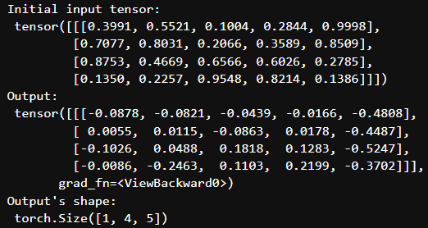
Layer – Feed Forward
nb_feed_forward.ipynb
import sys
sys.path.append('../')
import torch
from transformer.layer import FeedForward
# Initiate configuration
d_model = 5
batch_size=1
seq_len=4
d_ff = 2048
dropout = 0.1
# Create an instance of the FeedForward class
ff = FeedForward(d_model, d_ff, dropout)
# Create a random tensor to represent a batch of sequences
torch.manual_seed(68) # for reproducible result of random process
x = torch.rand(batch_size, seq_len, d_model)
# Pass the tensor through the feed-forward network
output = ff(x)
print("Initial input tensor: \n", x)
print("Output: \n", output)
print("Output's shape: \n", output.shape)

Slide 101
Transformer building block

Slide 102
Layer – Layer Normalization
layer.py
class LayerNorm(nn.Module):
def __init__(self, d_model: int, eps: float = 1e-6) -> None:
super().__init__()
# Initialize the scale and shift parameters, which are learnable.
self.para_mul = nn.Parameter(torch.ones(d_model))
self.para_bias = nn.Parameter(torch.zeros(d_model))
# Store the epsilon value.
self.eps = eps
def forward(self, x): # x: [batch_size, seq_len, d_model]
# Calculate the mean and standard deviation of the input
mean = x.mean(dim=-1, keepdim=True)
std = x.std(dim=-1, keepdim=True)
# Scale and shift the normalized value, [batch_size, seq_len, d_model]
return (self.para_mul * (x - mean) / (std + self.eps) + self.para_bias)

Slide 103
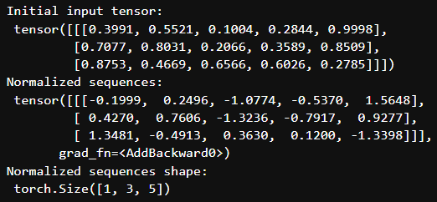
Layer – Layer Normalization
nb_layer_normalization.ipynb
import sys
sys.path.append('../')
import torch
from transformer.layer import LayerNorm
# Initiate configuration
d_model = 5
batch_size = 1
seq_len = 3
# Create an instance of our LayerNorm class
layer_norm = LayerNorm(d_model)
# Create a random tensor to represent a batch of sequences
torch.manual_seed(68) # for reproducible result
x = torch.rand(batch_size, seq_len, d_model)
# Pass our sequences through the layer normalization
normalized_sequences = layer_norm(x)
print("Initial input tensor: \n", x)
print("Normalized sequences: \n", normalized_sequences)
print("Normalized sequences shape: \n", normalized_sequences.shape)

Slide 105
Transformer building block

Slide 106
Layer – Residual Connection
layer.py
class ResidualConnection(nn.Module):
def __init__(self, d_model: int, dropout: float) -> None:
super().__init__()
# Initialize the layer normalization layer.
self.norm = LayerNorm(d_model)
# Initialize the dropout layer.
self.dropout = nn.Dropout(dropout)
def forward(self, x, sublayer): # x: [batch_size, seq_len, d_model]
# Apply layer normalization to the input, passes the result through the sublayer
return x + self.dropout(sublayer(self.norm(x))) # [batch_size, seq_len, d_model]

Slide 107
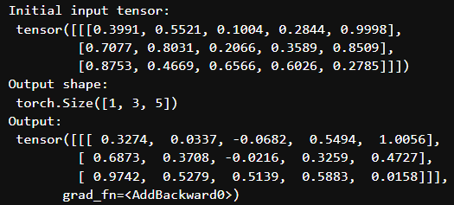
Layer – Residual Connection
nb_residual_connection.ipynb
import sys
sys.path.append('../')
import torch
from transformer.layer import FeedForward, ResidualConnection
# Initiate configuration
d_model = 5
d_ff=2048
batch_size=1
seq_len=3
dropout = 0.1
# Create an instance of the ResidualConnection and FeedForward classes
residual_connection = ResidualConnection(d_model, dropout)
feed_forward = FeedForward(d_model, d_ff=d_ff, dropout=dropout)
# Create a random input tensor
torch.manual_seed(68) # reproducible
x = torch.rand(batch_size, seq_len, d_model)
# Call residual connection
output = residual_connection(x, feed_forward)
print("Initial input tensor: \n", x)
print("Output shape: \n", output.shape)
print("Output: \n", output)

Slide 109
Transformer building block

Slide 110
Layer – Projection
layer.py
class Projection(nn.Module):
def __init__(self, d_model: int, vocab_size: int) -> None:
super().__init__()
# Initialize the linear transformation
# that projects the input into the vocabulary space.
self.projection = nn.Linear(d_model, vocab_size)
def forward(self, x): # x: [batch_size, seq_len, d_model]
# It applies the linear transformation to the input.
return self.projection(x) # [batch_size, seq_len, vocab_size].

Slide 111
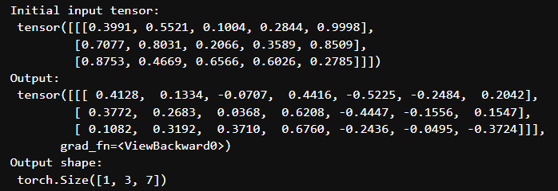
Layer – Projection
nb_projection.ipynb
import sys
sys.path.append('../')
import torch
from transformer.layer import Projection
# Initiate configuration
d_model = 5
vocab_size = 7
batch_size=1
seq_len=3
# Create an instance of the Projection class
projection = Projection(d_model, vocab_size)
# Create a random tensor to represent a batch of sequences
torch.manual_seed(68) # for reproducible result
x = torch.rand(batch_size, seq_len, d_model)
# Pass the tensor through the projection
output = projection(x)
print("Initial input tensor: \n", x)
print("Output: \n", output)
print("Output shape: \n", output.shape)

Slide 113
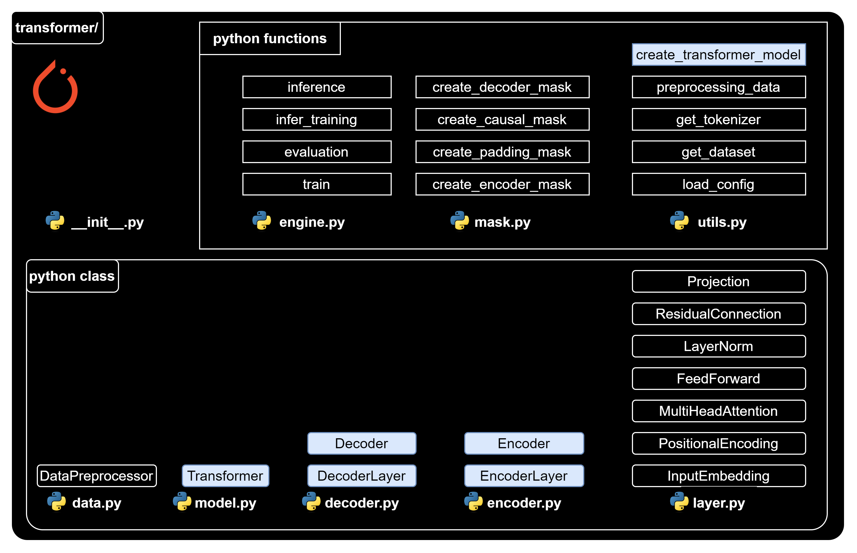
Class/function to create transformer

Slide 115
Class/function to create transformer

Slide 116
Encoder Layer
encoder.py
import torch.nn as nn
from transformer.layer import FeedForward, MultiHeadAttention, ResidualConnection, LayerNorm
class EncoderLayer(nn.Module):
def __init__(self, d_model: int, self_attention: MultiHeadAttention, feed_forward: FeedForward, dropout: float,
) -> None:
super().__init__()
self.self_attention = self_attention
self.feed_forward = feed_forward
# Initialize the residual connections.
self.residual_connections = nn.ModuleList([ResidualConnection(d_model, dropout) for _ in range(2)])

Slide 117
Encoder Layer
encoder.py
def forward(self, x, mask_scr=None):
# x: [batch_size, seq_len, d_model]
# First, it applies the self-attention mechanism to the input inside a residual connection.
x = self.residual_connections[0](x, lambda x: self.self_attention(x, x, x, mask_scr))
# Then, it passes the result through the feed-forward network inside another residual connection.
x = self.residual_connections[1](x, self.feed_forward)
return x # [batch_size, seq_len, d_model].

Slide 119
Class/function to create transformer

Slide 120
Encoder
encoder.py
class Encoder(nn.Module):
def __init__(self, d_model: int, encoder_layer: EncoderLayer, num_layers: int) -> None:
super().__init__()
# Initialize the layers of the encoder.
self.layers = nn.ModuleList([encoder_layer for _ in range(num_layers)])
# Initialize the layer normalization.
self.norm = LayerNorm(d_model)

Slide 121
Encoder
encoder.py
# The forward method is called when we pass input data into this module.
def forward(self, x, mask_scr=None):
# x: [batch_size, seq_len, d_model]
# It passes the input through each layer in turn.
for layer in self.layers:
x = layer(x, mask_scr)
# Finally, it applies layer normalization to the output of the last layer.
return self.norm(x) # [batch_size, seq_len, d_model].

Slide 122
Playground - Encoder
nb_encoder.ipynb
import torch
from transformer.layer import MultiHeadAttention, FeedForward, LayerNorm
from transformer.encoder import EncoderLayer, Encoder
# Define configuration
d_model = 6 # feature dimension
h = 3 # number of heads
dropout = 0.1 # dropout ratio
d_ff = 2048 # the dimension of the feed forward network
batch = 1 # batch size
seq_len = 4 # sequence length num_layers = 3 # number of encoder layer
# Create an instance of the MultiHeadAttention & FeedForward classes
self_attention_engine = MultiHeadAttention(d_model, h, dropout)
feed_forward = FeedForward(d_model, d_ff, dropout)
# Create an instance of the EncoderLayer class
encoder_layer = EncoderLayer(d_model, self_attention_engine, feed_forward, dropout)
# Create an instance of the Encoder class
encoder = Encoder(d_model, encoder_layer, num_layers)

Slide 123
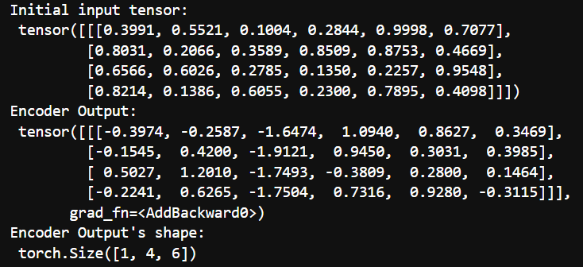
Playground - Encoder
nb_encoder.ipynb
# Create a random tensor to represent a batch of sequences
torch.manual_seed(68) # for reproducible result of random process
x = torch.rand(batch, seq_len, d_model)
# Pass the tensor through the encoder
output = encoder(x)
print("Initial input tensor: \n", x)
print("Encoder Output: \n", output)
print("Encoder Output's shape: \n", output.shape)

Slide 125
Class/function to create transformer

Slide 126
Decoder Layer
decoder.py
import torch.nn as nn
from transformer.layer import FeedForward, MultiHeadAttention, ResidualConnection, LayerNorm
class DecoderLayer(nn.Module):
def __init__(self, d_model: int, self_attention: MultiHeadAttention,
encoder_decoder_attention: MultiHeadAttention,
feed_forward: FeedForward, dropout: float) -> None:
super().__init__()
self.self_attention_engine = self_attention
self.encoder_decoder_attention = encoder_decoder_attention
self.feed_forward = feed_forward
# Initialize the residual connections.
self.residual_connections =
nn.ModuleList([ResidualConnection(d_model, dropout) for _ in range(3)])

Slide 127
Decoder Layer
decoder.py
def forward(self, x, encoder_output, mask_src=None, mask_tgt=None):
# x: [batch_size, seq_de, d_model], encoder_output: [batch_size, seq_len, d_model]
x = self.residual_connections[0](x, lambda x: self.self_attention_engine(x, x, x, mask_tgt))
x = self.residual_connections[1](x, lambda x: self.encoder_decoder_attention(x, encoder_output, encoder_output, mask_src))
x = self.residual_connections[2](x, self.feed_forward)
return x

Slide 129
Class/function to create transformer

Slide 130
Decoder
decoder.py
class Decoder(nn.Module):
def __init__(self, d_model: int, decoder_layer: DecoderLayer, num_layers: int) -> None:
super().__init__()
# Initialize the layers of the decoder.
self.layers = nn.ModuleList([decoder_layer for _ in range(num_layers)])
# Initialize the layer normalization.
self.norm = LayerNorm(d_model)

Slide 131
Decoder
decoder.py
def forward(self, x, encoder_output, mask_src=None, mask_tgt=None):
# x: [batch_size, seq_len, d_model]
# It passes the input and the encoder output through each layer in turn.
for layer in self.layers:
x = layer(x, encoder_output, mask_src, mask_tgt)
# Finally, it applies layer normalization to the output of the last layer.
return self.norm(x) # [batch_size, seq_len, d_model].

Slide 132
Playground Decoder
nb_decoder.ipynb
import torch
from transformer.layer import MultiHeadAttention, FeedForward, LayerNorm
from transformer.decoder import DecoderLayer, Decoder
# Define configuration
d_model = 6 # feature dimension
h = 6 # number of heads
dropout = 0.1 # dropout ratio
d_ff = 2048 # the dimension of the feed forward network
batch_size = 1 # batch size
seq_len = 4 # sequence length
num_layers = 3 # number of encoder layer
# Create an instance of the MultiHeadAttention and FeedForward classes
self_attention = MultiHeadAttention(d_model, h, dropout)
encoder_decoder_attention = MultiHeadAttention(d_model, h, dropout)
feed_forward = FeedForward(d_model, d_ff, dropout)
# Create an instance of the DecoderLayer class
decoder_layer = DecoderLayer(d_model, self_attention, encoder_decoder_attention, feed_forward, dropout)

Slide 133
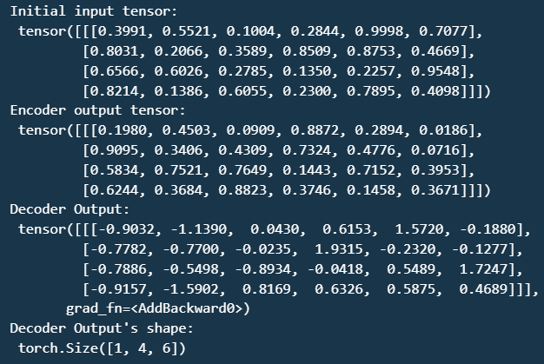
Playground Decoder
nb_decoder.ipynb
# Create an instance of the Decoder class
decoder = Decoder(d_model, decoder_layer, num_layers)
# Create a random tensor to represent a batch of sequences
torch.manual_seed(68) # for reproducible result of random process
x = torch.rand(batch_size, seq_len, d_model)
torch.manual_seed(101) # for reproducible result of random process
encoder_output = torch.rand(batch_size, seq_len, d_model)
# Pass the tensor through the decoder
output = decoder(x, encoder_output)
print("Initial input tensor: \n", x)
print("Encoder output tensor: \n", encoder_output)
print("Decoder Output: \n", output)
print("Decoder Output's shape: \n", output.shape)

Slide 135
Class/function to create transformer

Slide 136
Transformer class
model.py
import torch.nn as nn
from transformer.layer import InputEmbedding, PositionalEncoding, Projection
from transformer.encoder import Encoder
from transformer.decoder import Decoder
class Transformer(nn.Module):
def __init__(self, encoder: Encoder,
decoder: Decoder,
embed_src: InputEmbedding,
embed_tgt: InputEmbedding,
pos_src: PositionalEncoding,
pos_tgt: PositionalEncoding,
projection: Projection,
) -> None:
super().__init__()
self.encoder = encoder
self.decoder = decoder
self.embed_src = embed_src
self.embed_tgt = embed_tgt
self.pos_src = pos_src
self.pos_tgt = pos_tgt
self.projection = projection

Slide 137
Transformer class
model.py
def encode(self, src, mask_src=None):
src = self.embed_src(src)
src = self.pos_src(src)
return self.encoder(src, mask_src)
def decode(self, tgt, encoder_output, mask_src=None, mask_tgt=None):
tgt = self.embed_tgt(tgt)
tgt = self.pos_tgt(tgt)
return self.decoder(tgt, encoder_output, mask_src, mask_tgt)
def project(self, x):
return self.projection(x)

Slide 139
Class/function to create transformer

Slide 140
Utils – Create transformer model
utils.py
def create_tranformer_model(config, vocab_size_src, vocab_size_tgt) -> Transformer:
# Extract parameters from the configuration
d_model = config["d_model"]
num_layers = config["num_layers"]
h = config["h"]
d_ff = config["d_ff"]
dropout = config["dropout"]
seq_len = config["seq_len"]
# Initialize the source and target embedding layers
embed_src = InputEmbedding(vocab_size_src, d_model)
embed_tgt = InputEmbedding(vocab_size_tgt, d_model)

Slide 141
Utils – Create transformer model
utils.py
# Initialize the source & target positional encoding layers
pos_src = PositionalEncoding(d_model, seq_len, dropout)
pos_tgt = PositionalEncoding(d_model, seq_len, dropout)
# Initialize the encoder with self-attention and feed-forward layers
self_attention_encoder = MultiHeadAttention(d_model, h, dropout)
feed_forward_encoder = FeedForward(d_model, d_ff, dropout)
encoder_layer = EncoderLayer(
d_model, self_attention_encoder, feed_forward_encoder, dropout)
encoder = Encoder(d_model, encoder_layer, num_layers)

Slide 142
Utils – Create transformer model
utils.py
# Initialize the decoder with self-attention, encoder-decoder attention, and feed-forward layers
self_attention_decoder = MultiHeadAttention(d_model, h, dropout)
encoder_decoder_attention = MultiHeadAttention(d_model, h, dropout)
feed_forward_decoder = FeedForward(d_model, d_ff, dropout)
decoder_layer = DecoderLayer(
d_model,
self_attention_decoder,
encoder_decoder_attention,
feed_forward_decoder,
dropout,
)
decoder = Decoder(d_model, decoder_layer, num_layers)
# Initialize the projection layer
projection = Projection(d_model, vocab_size_tgt)

Slide 143
Utils – Create transformer model
utils.py
# Initialize the Transformer model
transformer = Transformer(
encoder,
decoder,
embed_src,
embed_tgt,
pos_src,
pos_tgt,
projection,
)
# Initialize the model parameters with Xavier uniform distribution
for param in transformer.parameters():
if param.dim() > 1:
nn.init.xavier_uniform_(param)
return transformer

Slide 144
Put it all together – Playground transformer
nb_transformer.ipynb
import sys
sys.path.append('../')
import torch
from transformer.utils import create_tranformer_model
from transformer.utils import load_config, get_dataset, get_tokenizer
## Get Config, dataset, tokenizers
config_file_path = "../config.json"
config = load_config(config_file_path)
dataset = get_dataset(config)
tokenizer_src = get_tokenizer(config, dataset, config['language_source'])
tokenizer_tgt = get_tokenizer(config, dataset, config['language_target'])
## Define model, random input and get random output
# Define the dimensions and vocabulary size
# Define the parameters for the transformer model
vocab_size_src = 10000
vocab_size_tgt = 10000
seq_len = 100
batch_size=1
# Create the transformer model
transformer = create_tranformer_model(
config,
vocab_size_src,
vocab_size_tgt,
)

Slide 145
Put it all together – Playground transformer
nb_transformer.ipynb
# Now you can use the transformer model for encoding, decoding, and projecting
# For example, to encode a batch of source sequences:
torch.manual_seed(68) # for reproducible result of random process
src = torch.randint(0, vocab_size_src, (batch_size, seq_len)) # [batch_size, seq_len]
encoder_output = transformer.encode(src)
# And to decode a batch of target sequences:
torch.manual_seed(101) # for reproducible result of random process
tgt = torch.randint(0, vocab_size_tgt, (batch_size, seq_len)) # [batch_size, seq_len]
decoder_output = transformer.decode(tgt, encoder_output)
# And to project the decoder output:
projected_output = transformer.project(decoder_output)
# predicted_token is the indice of the max value in projection_output
_, predicted_tokens_tensors = torch.max(projected_output, dim=1)
# Convert predicted tokens to numpy array
predicted_tokens = predicted_tokens_tensors.squeeze(0)
predicted_tokens = predicted_tokens.detach().cpu().numpy()

Slide 146
Put it all together – Playground transformer
nb_transformer.ipynb
## Find the EOS token
for idx, eos in enumerate(predicted_tokens):
if eos == 3:
eos_idx = idx
break
## Get predicted sequence until EOS
predicted_token_sequence = predicted_tokens[:eos_idx]
## Word decode
# Pass the tensor through the target tokenizer
decoded_words = tokenizer_tgt.decode(predicted_token_sequence)
print("Predicted sequence: \n", decoded_words)

Slide 149
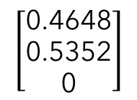
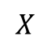
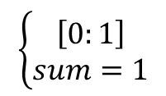









Softmax function
$$\frac{e^{X_{i}}}{\sum_{j}^{N}{e^{X_{j}}}}$$
$$X_{i}$$
$$Y_{i}$$
$$\left[\begin{aligned}1 \\ 2 \\ 4\end{aligned}\right]$$
$$\left[\begin{aligned}\text{0.}\text{0420} \\ \text{0.}\text{11}\text{4}\text{2} \\ \text{0.}8438\end{aligned}\right]$$
$$X$$
$$Y$$
softmax
$$\left\{\begin{aligned}\left[0:1\right] \\ sum=1\end{aligned}\right.$$
$$\left[\begin{aligned}0.123 \\ 0.246 \\ −np.inf\end{aligned}\right]$$
$$\left[\begin{aligned}\text{0.4648} \\ \text{0.5352} \\ \text{0}\end{aligned}\right]$$
$$X$$
$$Y$$
softmax

Slide 150

Softmax function
nb_softmax_fn.ipynb
import torch
import numpy as np
# create an input tensor
input_tensor = torch.tensor([0.123, 0.264, -np.inf])
# apply softmax to the input tensor to obtain the output tensor
output_tensor = torch.softmax(input_tensor, dim=0)
print("input_tensor: \n", input_tensor)
print("output_tensor: \n", output_tensor)

Slide 152



Cross Entropy Loss
Context
Given a machine translation task of transformer
Translate French sentence to English sentence
Configurations
seq_len = 3
en_vocabulary_size = 4
english_tokenizer:
{"Am" : 0,"Fine": 1,"I": 2,
"Hi": 3}
1st step
Source sentence (Fr)
Predictions
Target sentence (En)
Modeling
Prediction
"Je
Vais
Bien"
[[0.3, 0.2, 0.4, 0.1],
"I
Am
Fine"
[2,
0,
1]
Transformer
[0.4, 0.1, 0.3, 0.2],
[0.3, 0.5, 0.1, 0.2]]
2nd step
softmax
Softmax
Select prob corresponding to true label
[[0.2612, 0.2363, 0.2887, 0.2138],
[0.2887, 0.2138, 0.2612, 0.2363],
[0.2535, 0.3096, 0.2075, 0.2294]]
3rd step
$$cross_entropy_loss$$
$$=$$
$$mean(−\log\left(0.2887, 0.2887, 0.3096\right))$$
Compute the negative log
Take average on the result
$$\frac{−\log\left(\text{0.2887}\right)−log⁡(\text{0.2887})−log⁡(\text{0}.3096)}{3}=1.2192$$
$$=$$

Slide 153

Cross Entropy Loss
nb_loss_fn.ipynb
import torch
import torch.nn.functional as F
# Suppose we have prediction
prediction = torch.tensor([[0.3, 0.2, 0.4, 0.1], [0.4, 0.1, 0.3, 0.2], [0.3, 0.5, 0.1, 0.2]]) # Suppose we have target indexes
target = torch.tensor([2, 0, 1])
# Apply softmax to the prediction
proba_sofmax = F.softmax(prediction, dim=1) # Select the probabilities corresponding to the true classes
selected_proba = proba_sofmax[range(len(target)), target]
# Compute the negative log likelihood loss
manual_cross_entropy_loss = -torch.log(selected_proba).mean()
# Print out results
print("prediction: {} \n".format(prediction))
print("target: {} \n".format(target))
print("proba_sofmax: {}\n".format(proba_sofmax))
print("selected_proba: {}\n".format(selected_proba))
print("manual_cross_entropy_loss: {}\n".format(manual_cross_entropy_loss))

Slide 154

Cross Entropy Loss
nb_loss_fn.ipynb
import torch
import torch.nn as nn
# Define the loss function
loss_fn = nn.CrossEntropyLoss()
# Suppose we have prediction
prediction = torch.tensor([[0.3, 0.2, 0.4, 0.1], [0.4, 0.1, 0.3, 0.2], [0.3, 0.5, 0.1, 0.2]])
# Suppose we have target indexes
target = torch.tensor([2, 0, 1])
# Compute the cross entropy loss
loss = loss_fn(prediction, target)
# Print out results
print("prediction: {} \n".format(prediction))
print("target: {} \n".format(target))
print("cross_entropy_loss: {} \n".format(loss))

Slide 155

Engine functions for training

Slide 157
Engine functions for training

Slide 158
Engine – Train
engine.py
import os
import torch
import torch.nn as nn
from torch.utils.tensorboard import SummaryWriter
import torchmetrics.text as metrics
from transformer.mask import create_causal_mask from tqdm import tqdm
from transformer.utils import create_tranformer_model, get_checkpoint_path, create_checkpoint_path,
from transformer.utils import preprocessing_data
def train(config):
# Assign the device for computation (GPU if available, else CPU)
device = torch.device("cuda" if torch.cuda.is_available() else "cpu")
print(f"Using {device} device")
# Initiate TensorBoard writer for logging training metrics
logs = SummaryWriter(config["log_dir"])

Slide 159
Engine – Train
engine.py
# Check if model directory exists, if not create one to save the model weights
if not os.path.exists(config["model_dir"]):
os.mkdir("models")
# Load and preprocess the dataset
(train_dataloader, val_dataloader, _, tokenizer_src, tokenizer_tgt,) = preprocessing_data(config)

Slide 160
Engine – Train
engine.py
# Get vocab size for source and target language
vocab_size_src = tokenizer_src.get_vocab_size()
vocab_size_tgt = tokenizer_tgt.get_vocab_size()
# Create the Transformer model
model = create_tranformer_model(config, vocab_size_src, vocab_size_tgt).to(device)
# Initialize the optimizer (Adam in this case)
optimizer = torch.optim.Adam(model.parameters(), lr=config["learning_rate"], eps=1e- 9)
initial_epoch = 0
global_step = 0
# Get the checkpoint path if exists
checkpoint_path = get_checkpoint_path(config)

Slide 161
Engine – Train
engine.py
# If a checkpoint exists, load the model and optimizer states and continue training from the last epoch
if checkpoint_path:
print(f"Loading checkpoint from {checkpoint_path}")
checkpoint = torch.load(checkpoint_path)
model.load_state_dict(checkpoint["model_state_dict"])
initial_epoch = checkpoint["epoch"] + 1
optimizer.load_state_dict(checkpoint["optimizer_state_dict"])
global_step = checkpoint["global_step"]
else:
print("No checkpoint found")

Slide 162
Engine – Train
engine.py
# Define the loss function (CrossEntropyLoss in this case)
loss_function = nn.CrossEntropyLoss(ignore_index=tokenizer_src.token_to_id("[PAD]"), label_smoothing=0.1).to(device)
# Training loop
for epoch in range(initial_epoch, config["epochs"]):
torch.cuda.empty_cache()
model.train()
batch_iterator = tqdm(train_dataloader, desc=f"Training Epoch {epoch}")
# Iterate over each batch in the training data
for batch in batch_iterator:
# Move the encoder and decoder inputs and masks to the device
encoder_input = batch["encoder_input_ids"].to(device) # (batch_size, seq_len)
decoder_input = batch["decoder_input_ids"].to(device) # (batch_size, seq_len)
encoder_mask = batch["encoder_mask"].to(device) # (batch_size, 1, 1, seq_len)
decoder_mask = batch["decoder_mask"].to(device) # (batch_size, 1, seq_len, seq_len)

Slide 163
Engine – Train
engine.py
# Pass the inputs through the model # (batch_size, seq_len, d_model)
encoder_output = model.encode(encoder_input, encoder_mask)
#(batch_size, seq_len_de, d_model)
decoder_output = model.decode(decoder_input, encoder_output, encoder_mask, decoder_mask)
# (batch_size, seq_len, vocab_size)
projection_output = model.project(decoder_output)
# Load target/label sequences # (batch_size, seq_len)
decoder_target = batch["decoder_target_ids"].to(device)

Slide 164
Engine – Train
engine.py
# Calculate loss
loss = loss_function(projection_output.view(-1, vocab_size_tgt), decoder_target.view(-1))
batch_iterator.set_postfix({"Training Loss": loss.item()})
# Log the loss to TensorBoard
logs.add_scalar("Training Loss", loss.item(), global_step)
logs.flush()
# Perform backpropagation
loss.backward()
# Update parameters
optimizer.step()
optimizer.zero_grad(set_to_none=True)
global_step += 1

Slide 165
Engine – Train
engine.py
# Run validation at the end of each epoch
evaluation(
model,
val_dataloader,
tokenizer_src,
tokenizer_tgt,
config["seq_len"],
global_step,
logs,
config["num_eval_samples"],
device,
)

Slide 166
Engine – Train
engine.py
# Save model checkpoint
model_checkpoint_path = create_checkpoint_path(config, f"{epoch:02d}")
torch.save(
{
"epoch": epoch,
"model_state_dict": model.state_dict(),
"optimizer_state_dict": optimizer.state_dict(),
"global_step": global_step,
},
model_checkpoint_path,
)

Slide 168
Engine functions for training

Slide 169
Engine – Evaluation during training
engine.py
def evaluation(model, val_dataloader, tokenizer_src, tokenizer_tgt, seq_len, global_step, logs, num_eval_samples, device):
# Set the model to evaluation mode
model.eval()
# Get the IDs for the start and end of sequence tokens
sos_id = tokenizer_src.token_to_id("[SOS]")
eos_id = tokenizer_src.token_to_id("[EOS]")
# Initialize lists to store the source texts, target texts, and predicted texts
source_texts = []
target_texts = []
predicted_texts = []

Slide 170
Engine – Evaluation during training
engine.py
# Disable gradient calculations
with torch.no_grad():
# Iterate over the validation data
for batch in val_dataloader:
# Get the encoder input and mask from the batch and move them to the device
encoder_input = batch["encoder_input_ids"].to(device) # (batch_size, seq_len)
encoder_mask = batch["encoder_mask"].to(device) # (batch_size, 1, 1, seq_len)
# Assert that the batch size is 1 for evaluation
assert encoder_input.shape[0] == encoder_mask.shape[0] == 1, "Batch size must be 1 for evaluation"

Slide 171
Engine – Evaluation during training
engine.py
# Perform inference using the model
model_output = infer_training(model, encoder_input, encoder_mask, sos_id, eos_id, seq_len, device)
# Get the source text, target text, and predicted text from the batch
source_text = batch["text_src"][0]
target_text = batch["text_tgt"][0]
predicted_text = tokenizer_tgt.decode(model_output.detach().cpu().numpy())
# Append the texts to their respective lists
source_texts.append(source_text)
target_texts.append(target_text)
predicted_texts.append(predicted_text)

Slide 172
Engine – Evaluation during training
engine.py
# Print the source text, target text, and predicted text
print(f"Source: {source_text}")
print(f"Target: {target_text}")
print(f"Predicted: {predicted_text}")
print("--------------------------------------------------")
# Break the loop if the number of evaluation samples has been reached
if len(source_texts) == num_eval_samples:
print("*************** EVALUATION COMPLETED - GO TO NEXT EPOCH ***************")
break

Slide 173
Engine – Evaluation during training
engine.py
if logs:
# calculate the BLEU score
bleu_metric = metrics.BLEUScore()
bleu_score = bleu_metric(predicted_texts, target_texts)
logs.add_scalar("Validation BLEU Score", bleu_score, global_step)
logs.flush()
# calculate the word error rate
wer_metric = metrics.WordErrorRate()
wer_score = wer_metric(predicted_texts, target_texts)
logs.add_scalar("Validation Word Error Rate", wer_score, global_step)
logs.flush()
# calculate character error rate
cer_metric = metrics.CharErrorRate()
cer_score = cer_metric(predicted_texts, target_texts)
logs.add_scalar("Validation Character Error Rate", cer_score, global_step)
logs.flush()

Slide 175
Engine functions for training

Slide 176
Engine – Inference during training
engine.py
def infer_training(model, encoder_input, encoder_mask, sos_id, eos_id, seq_len, device):
# Encode the input using the model # (batch_size, seq_len, d_model)
encoder_output = model.encode(encoder_input, encoder_mask)
# Initialize the decoder input with the start of sequence token
decoder_input = torch.tensor([[sos_id]]).type_as(encoder_input).to(device) # (1, 1)
# Loop until the sequence length of the decoder input equals the sequence length of the encoder input
while True:
if decoder_input.shape[1] == seq_len:
break

Slide 177
Engine – Inference during training
engine.py
# Create a causal mask for the decoder input
decoder_mask = create_causal_mask(decoder_input.shape[1]).type_as(encoder_mask).to(device)
# Decode the encoder output using the model
decoder_output = model.decode(decoder_input, encoder_output, encoder_mask, decoder_mask)
# select the last token from the seq_len dimension
last_token_output = decoder_output[:, -1, :]

Slide 178
Engine – Inference during training
engine.py
# project the output to the target vocab size
projection_output = model.project(last_token_output)
# predicted_token is the indice of the max value in projection_output, meaning the id in vocabulary
_, predicted_token = torch.max(projection_output, dim=1)
decoder_input = torch.cat([decoder_input, predicted_token.unsqueeze(0)
.type_as(encoder_input)
.to(device)], dim=1)
# Break the loop if the predicted token is the end of sequence token
if predicted_token == eos_id:
break
# Return the decoder input, removing the batch dimension
return decoder_input.squeeze(0)

Slide 180

Training in action
train.py
from transformer.engine import train
from transformer.utils import load_config
if __name__ == "__main__":
config_file_path = "config.json"
config = load_config(config_file_path)
train(config)

Slide 181


Training in action

Slide 183
Inference
Trained model
A sentence
Translated sentence

Slide 184

Engine function for inference

Slide 185
Inference
engine.py
def inference(src_text, model, tokenizer_src, tokenizer_tgt, seq_len, device):
# Set the model to evaluation mode.
model.eval()
# Disable gradient calculation.
with torch.no_grad():
# Tokenize the source text.
tokenized_src_text = tokenizer_src.encode(src_text)
# Calculate the number of padding tokens needed for the encoder input.
encoder_padding_num = seq_len - len(tokenized_src_text.ids) - 2 # 2: [SOS] & [EOS]
# Get the IDs of the special tokens.
sos_id = tokenizer_src.token_to_id("[SOS]")
eos_id = tokenizer_src.token_to_id("[EOS]")
pad_id = tokenizer_src.token_to_id("[PAD]")

Slide 186
Inference
engine.py
# Create the encoder input by concatenating the special tokens and the tokenized source text.
encoder_input = torch.cat(
[
torch.tensor([sos_id], dtype=torch.int64),
torch.tensor(tokenized_src_text.ids, dtype=torch.int64),
torch.tensor([eos_id], dtype=torch.int64),
torch.tensor([pad_id] * encoder_padding_num, dtype=torch.int64),
], dim=0
).to(device)
# Create the encoder mask.
encoder_mask = create_encoder_mask(encoder_input, pad_id).to(device)
# Encode the input.
encoder_output = model.encode(encoder_input, encoder_mask)
# Initialize the decoder input with the start of sequence token.
decoder_input = torch.tensor([[sos_id]]).type_as(encoder_input).to(device)

Slide 187
Inference
engine.py
# Loop until the sequence length is reached or the end of sequence token is predicted.
while True:
# Break the loop if the sequence length is reached.
if decoder_input.shape[1] == seq_len:
break
# Create the decoder mask.
decoder_mask = create_causal_mask(decoder_input.shape[1])
.type_as(encoder_mask)
.to(device)
# Decode the encoder output.
decoder_output = model.decode(
decoder_input,
encoder_output,
encoder_mask,
decoder_mask
)

Slide 188
Inference
engine.py
# Select the last token from the sequence length dimension.
last_token_output = decoder_output[:, -1, :]
# Project the output to the target vocabulary size.
projection_output = model.project(last_token_output)
# Get the predicted token by finding the index of the maximum value in the projection output.
_, predicted_token = torch.max(projection_output, dim=1)
# Update the decoder input by appending the predicted token.
decoder_input = torch.cat([
decoder_input, predicted_token.unsqueeze(0).type_as(encoder_input).to(device)
], dim=1)
# Break the loop if the predicted token is the end of sequence token.
if predicted_token == eos_id:
break

Slide 189
Inference
engine.py
# Decode the decoder input to get the translated text.
translated_text = tokenizer_tgt.decode(
decoder_input
.squeeze(0)
.detach()
.cpu()
.numpy()
)
return translated_text

Slide 191
Playground Inference – Machine translation
nb_inference.ipynb
import torch
from transformer.utils import create_tranformer_model
from transformer.utils import load_config, get_dataset, get_tokenizer
from transformer.utils import get_checkpoint_path
from transformer.engine import inference
# Assign the device for computation (GPU if available, else CPU)
device = torch.device("cuda" if torch.cuda.is_available() else "cpu")
print(f"Using {device} device")
## Get Config, dataset, tokenizers
config_file_path = "./config.json"
config = load_config(config_file_path)
dataset = get_dataset(config)
tokenizer_src = get_tokenizer(config, dataset, config['language_source'])
tokenizer_tgt = get_tokenizer(config, dataset, config['language_target'])
vocab_size_src = tokenizer_src.get_vocab_size()
vocab_size_tgt = tokenizer_tgt.get_vocab_size()
seq_len = config["seq_len"]

Slide 192
Playground Inference – Machine translation
nb_inference.ipynb
# Create the Transformer model
model = create_tranformer_model(config, vocab_size_src, vocab_size_tgt).to(device)
# Load latest checkpoint
model_checkpoint = get_checkpoint_path(config)
print("model_checkpoint:", model_checkpoint)
state = torch.load(model_checkpoint)
# Assign latest checkpoint to transfromer
model.load_state_dict(state['model_state_dict'])
# Source text to translate
source_text = "Market prices are shaped by the balance of supply and demand."
# call the translation function over the trained model and the source text translated_text = inference(source_text, model, tokenizer_src,
tokenizer_tgt, seq_len, device)

Slide 193

Playground Inference – Machine translation
nb_inference.ipynb
print("Source text: \n", source_text)
print(">>>>")
print("Translated text: \n", translated_text)

Slide 195
In summary
Implemented all building blocks of the Transformer.
Built the Transformer as a package.
Wrote a script to launch the training with several lines of code.
Tested the inference with the trained model for the use case of a machine translation task.
Provided a playground with notebooks for all functions and classes.

Slide 196
Thank you for your watching!
Subscribe, like, share

